Slide 1
The Developer’s Guide to Learning Effectively
Presentation may also work for other disciplines
Results pending official peer review
Ask your CTO if the Developer’s Guide is right for you

Slide 2



































TITANIUM SPONSORS
Platinum Sponsors
Gold Sponsors

Slide 3
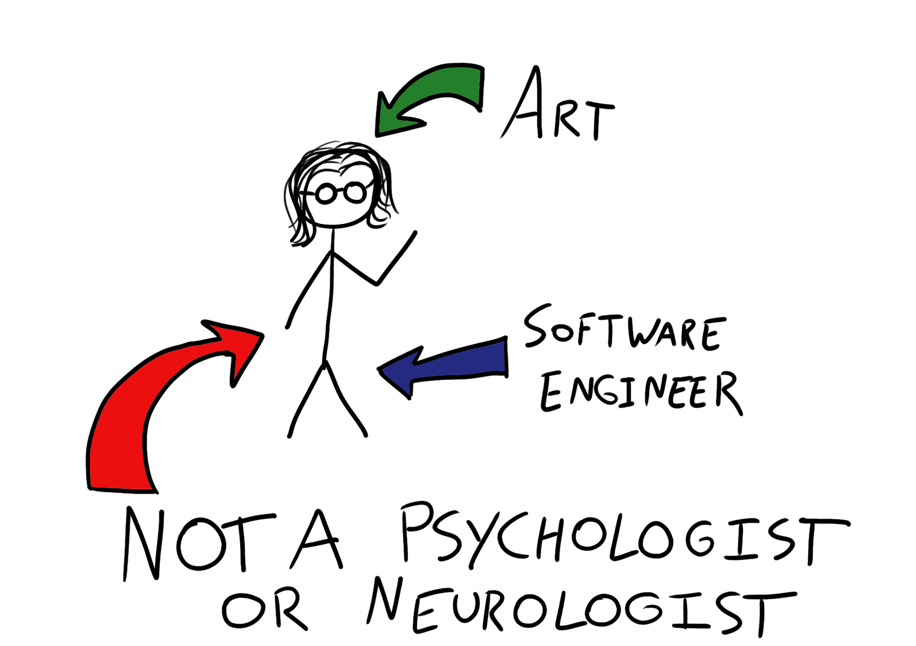

Slide 4
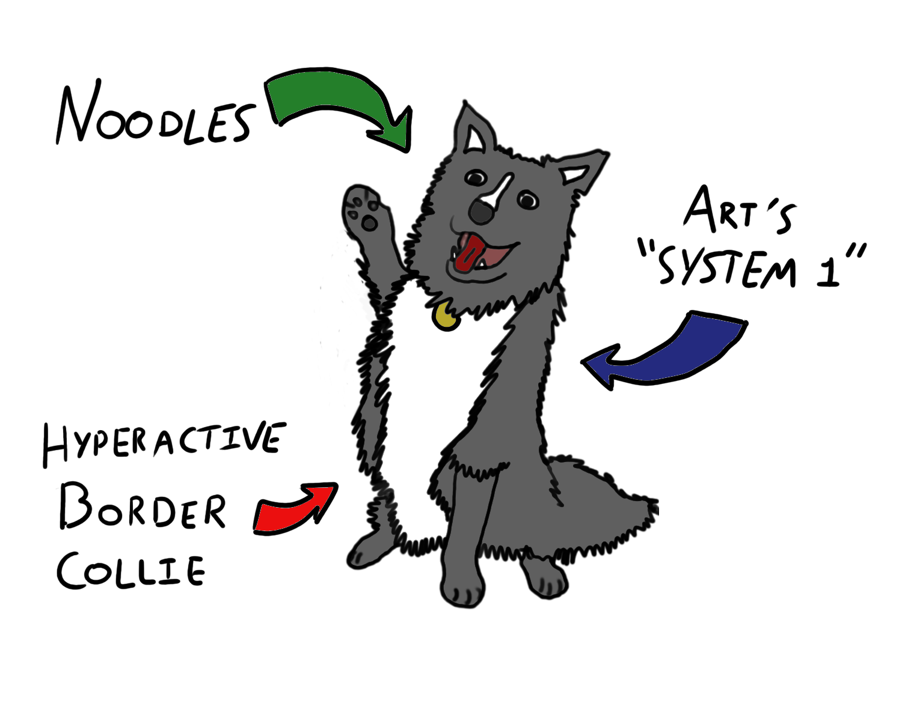
Notes:
Noodles is a personification of what Daniel Kahneman calls my “System 1” My intuitive, associative, unconscious self

Slide 5
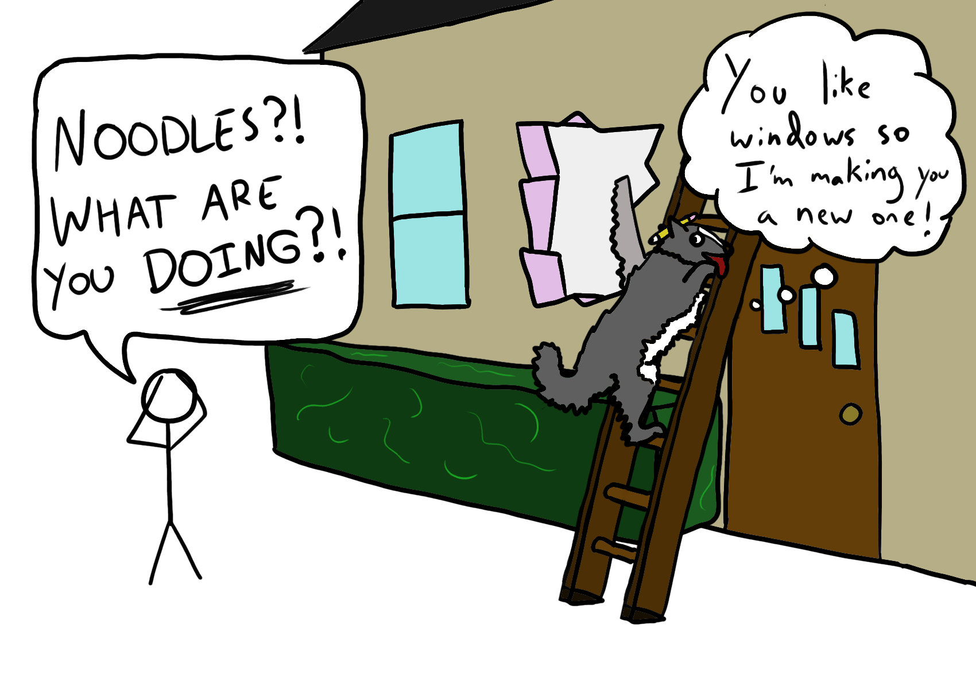
Notes:
He’s really helpful but he can cause some issues too

Slide 6
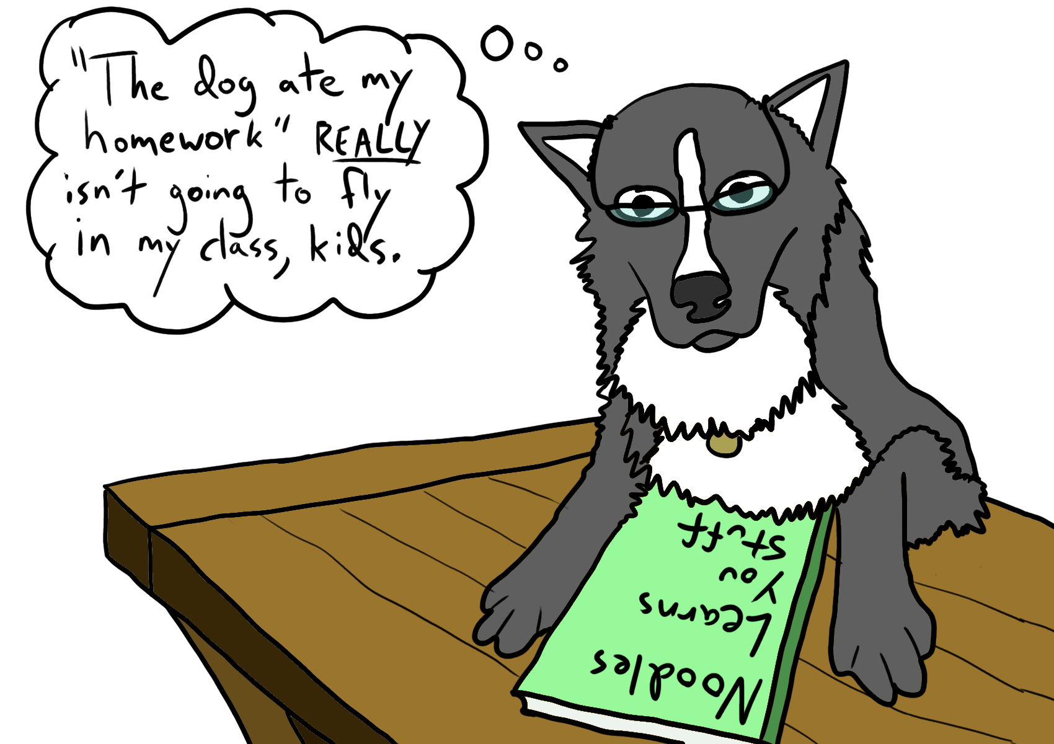

Slide 7
You don’t learn like you think you do
What we call “learning” is a bunch of different mechanisms
Feeling discomfort and strain is good for you

Slide 8
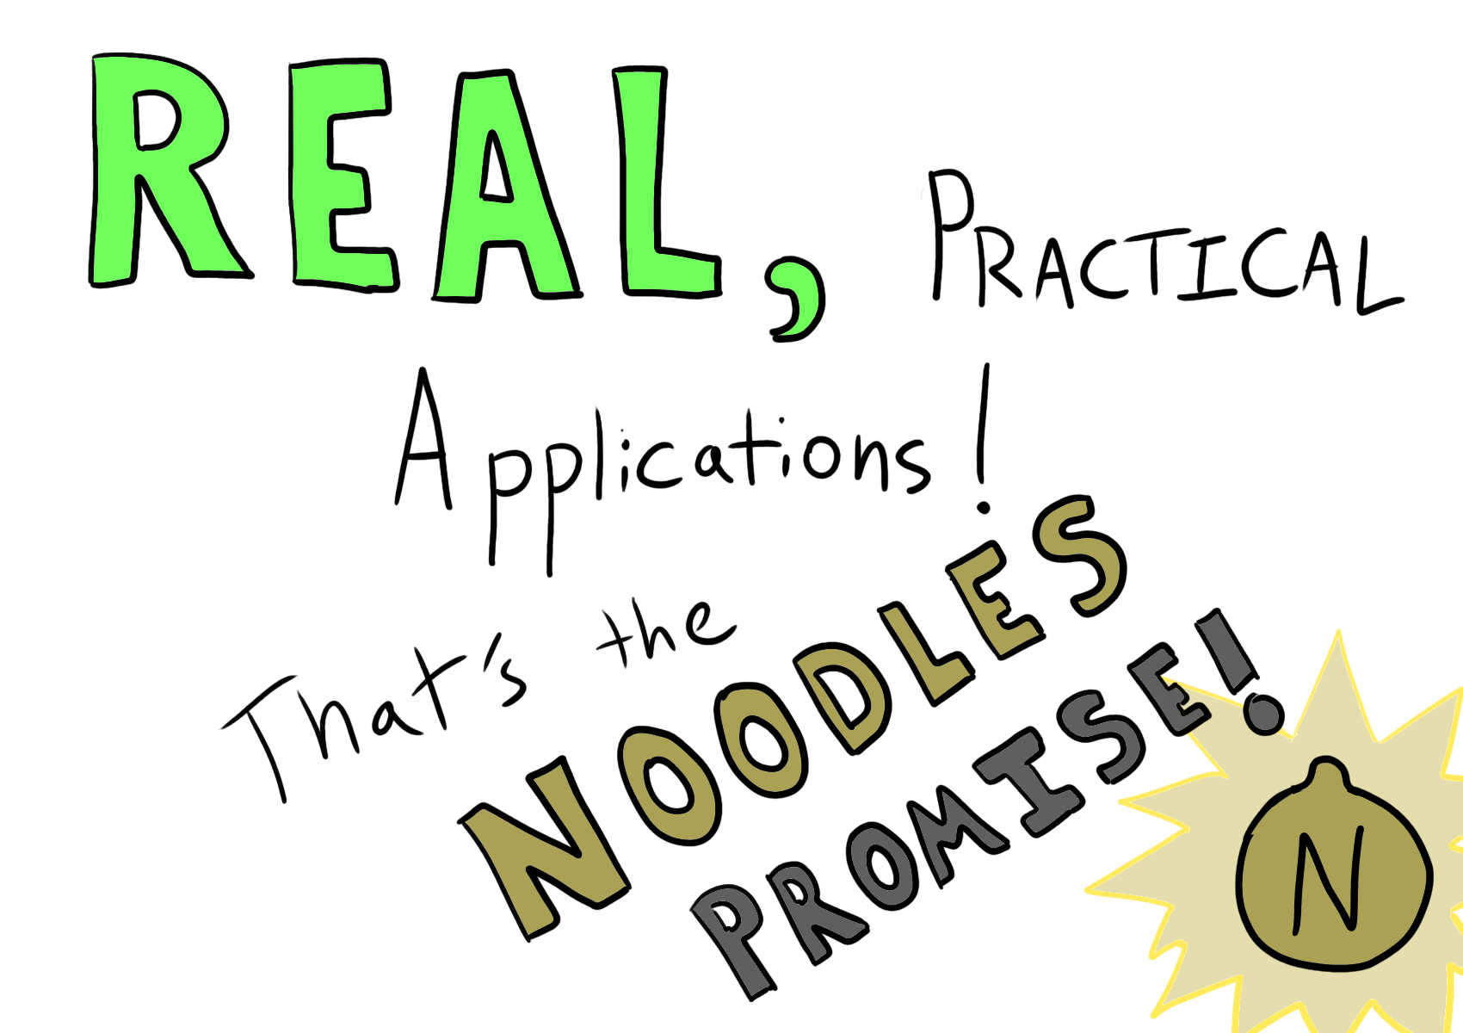

Slide 9
What’s your personal history with learning?

Slide 10
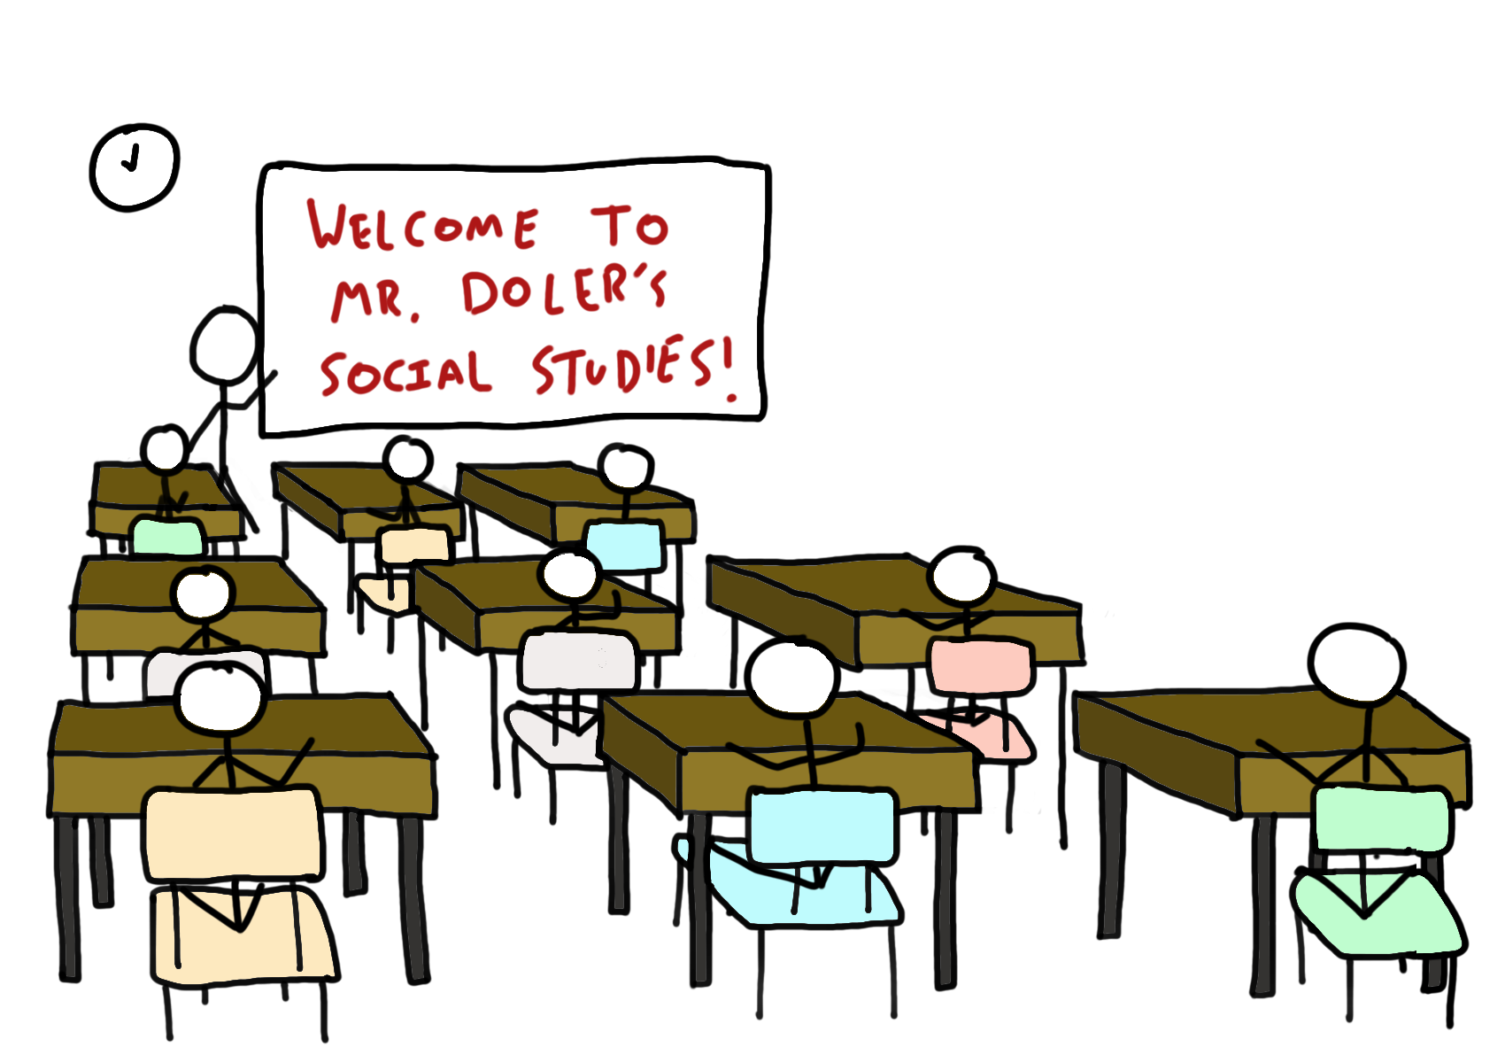
Notes:
Theory-focused
Typically lectures or readings
Reinforced with homework and exams

Slide 11
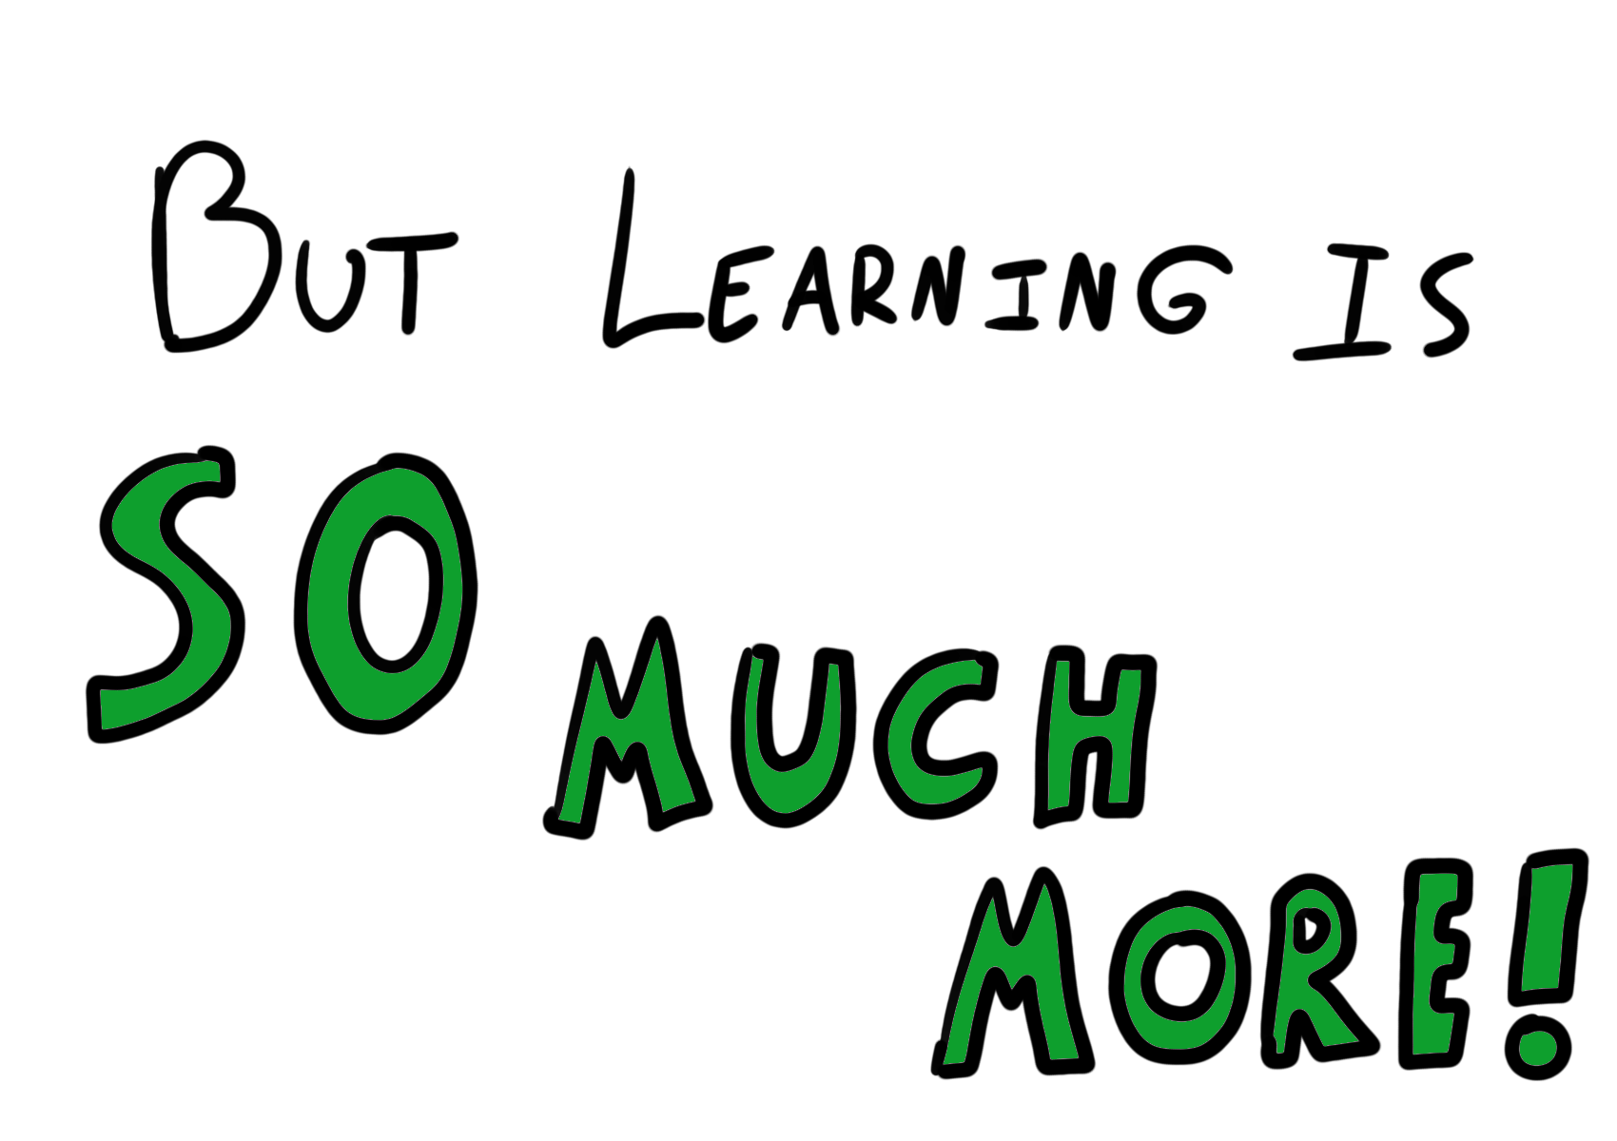

Slide 12
What about Learning Types?

Slide 13
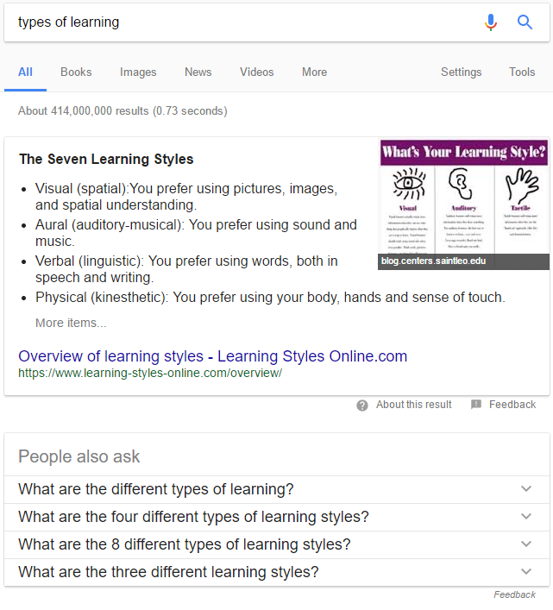
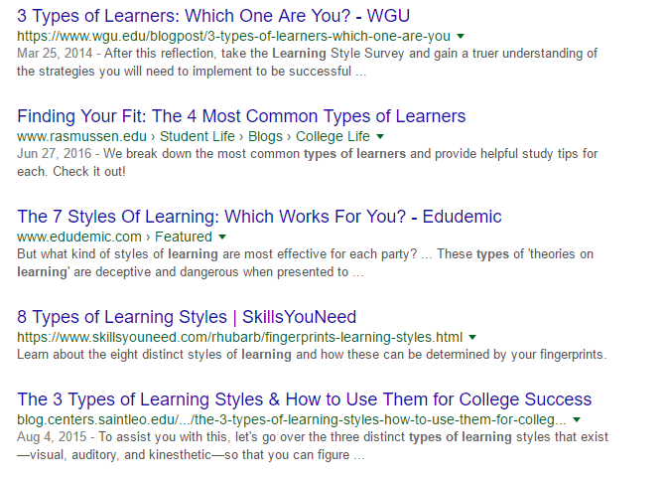
Google.com search for “types of learning”, retrieved on 2017/06/15

Slide 14
Visual
Auditory
Kinesthetic
The Linguistic Learner
The Naturalist.
The Musical or Rhythmic Learner
The Kinesthetic Learner
The Visual or Spatial Learner
The Logical or Mathematical Learner
The Interpersonal Learner
The Intrapersonal Learner
Visual
Aural
Verbal
Physical
Logical
Social
Solitary
Visual
Auditory
Read-Write
Kinesthetic

Slide 15
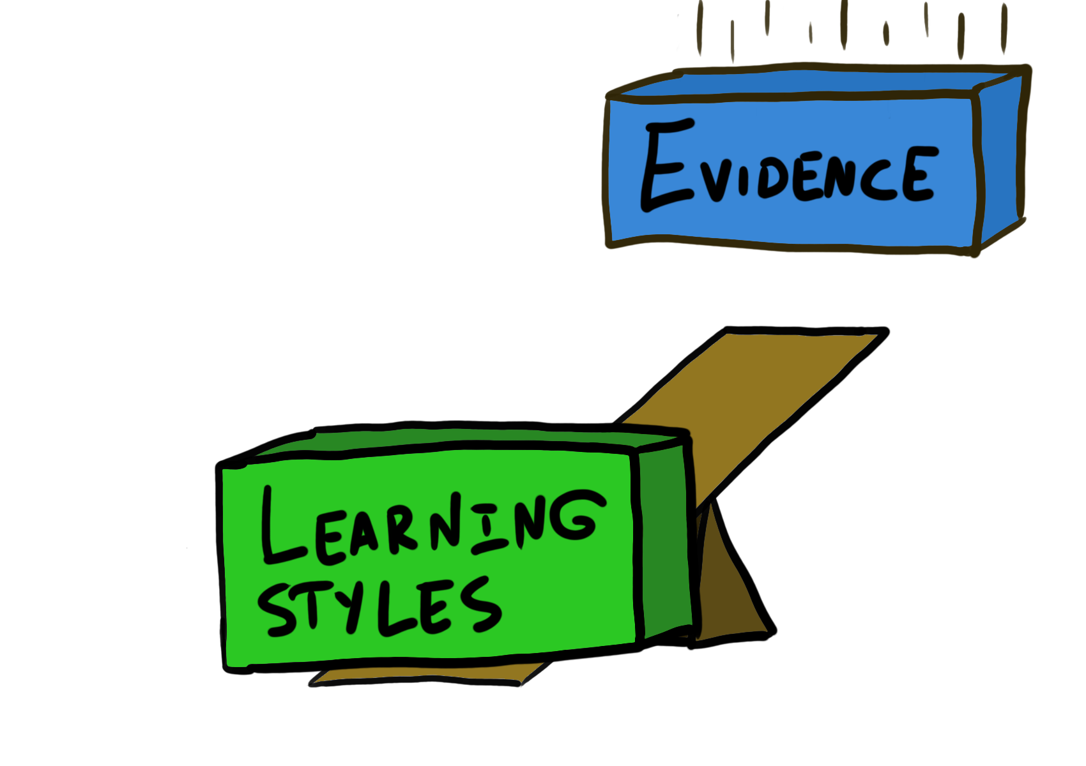
Notes:
Learning Styles/Types are heavily disputed

Slide 16
“…the appropriate design was used in only about 20 studies, and the results of most of them are compellingly negative.“
“By contrast, we are aware of only three appropriately designed studies that yielded a positive finding like that described in our hypothetical example, and these findings are not very convincing.”
Rohrer & Pashler, 2012

Slide 17
“Although there are a multitude of inventories and models for assessing learning styles, most are not reliable (Coffield, Moseley, Hall, & Ecclestone, 2004).”
“Is there support for either prediction – for educational practice, or barring that, at least that the theory might be correct (even if it’s not helpful)? No.”
Willingham, Hughes, and Dobolyi, 2015

Slide 18
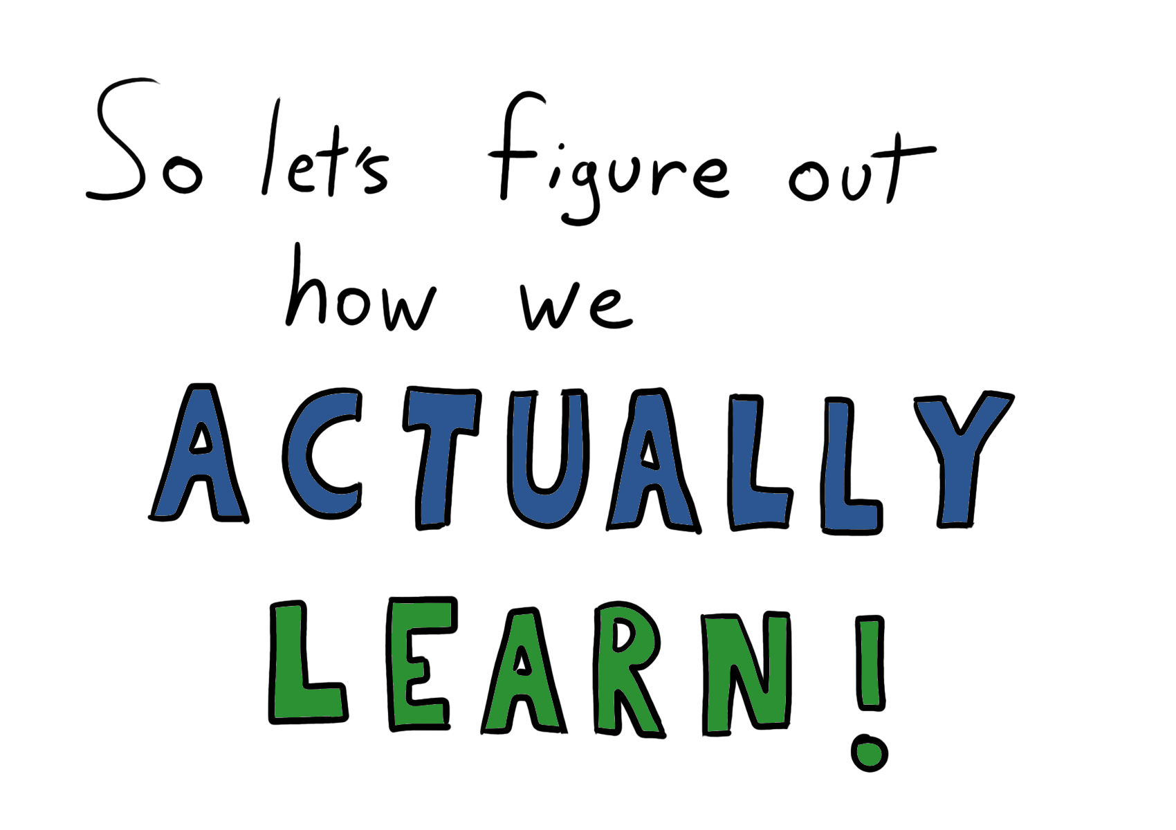

Slide 19
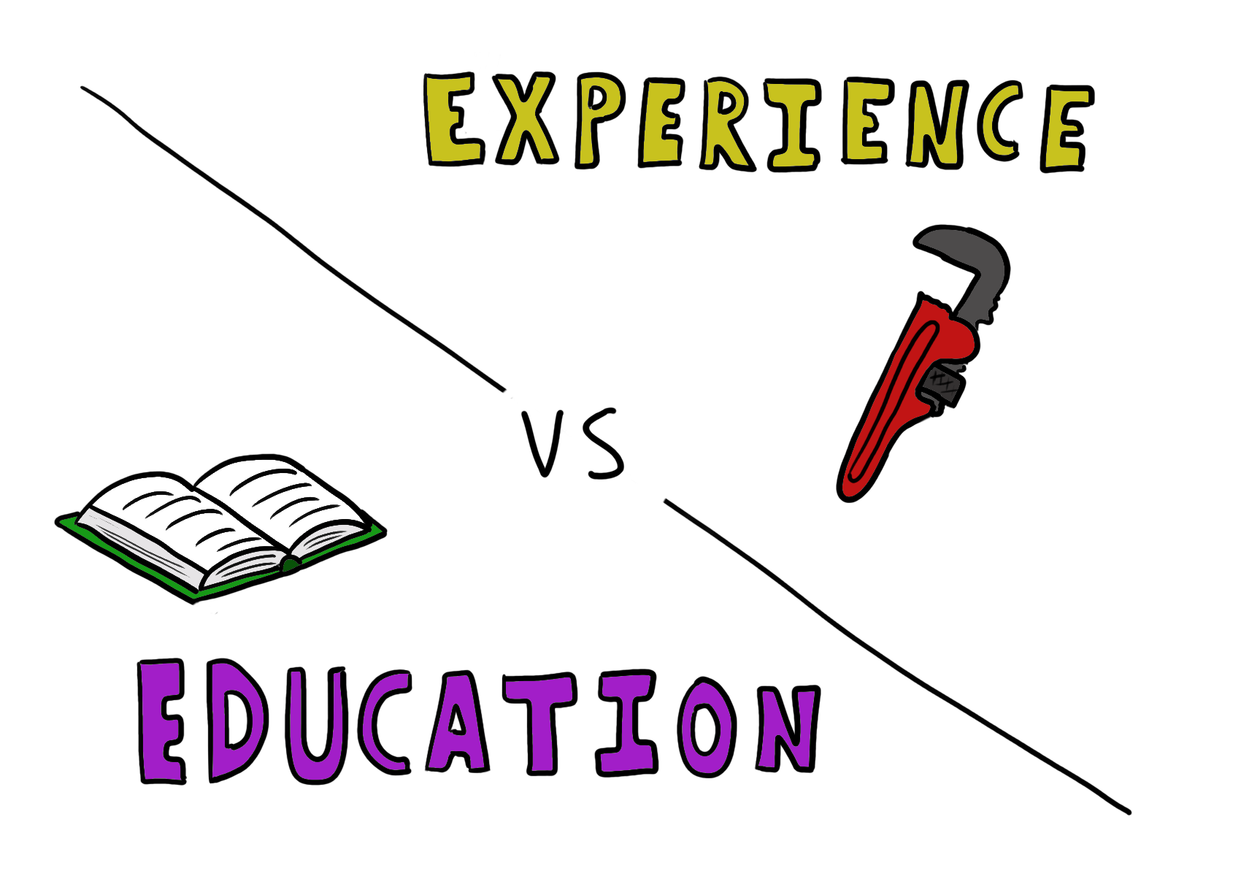
Notes:
We think about learning as Education vs experience … and we feel that they’re different

Slide 20
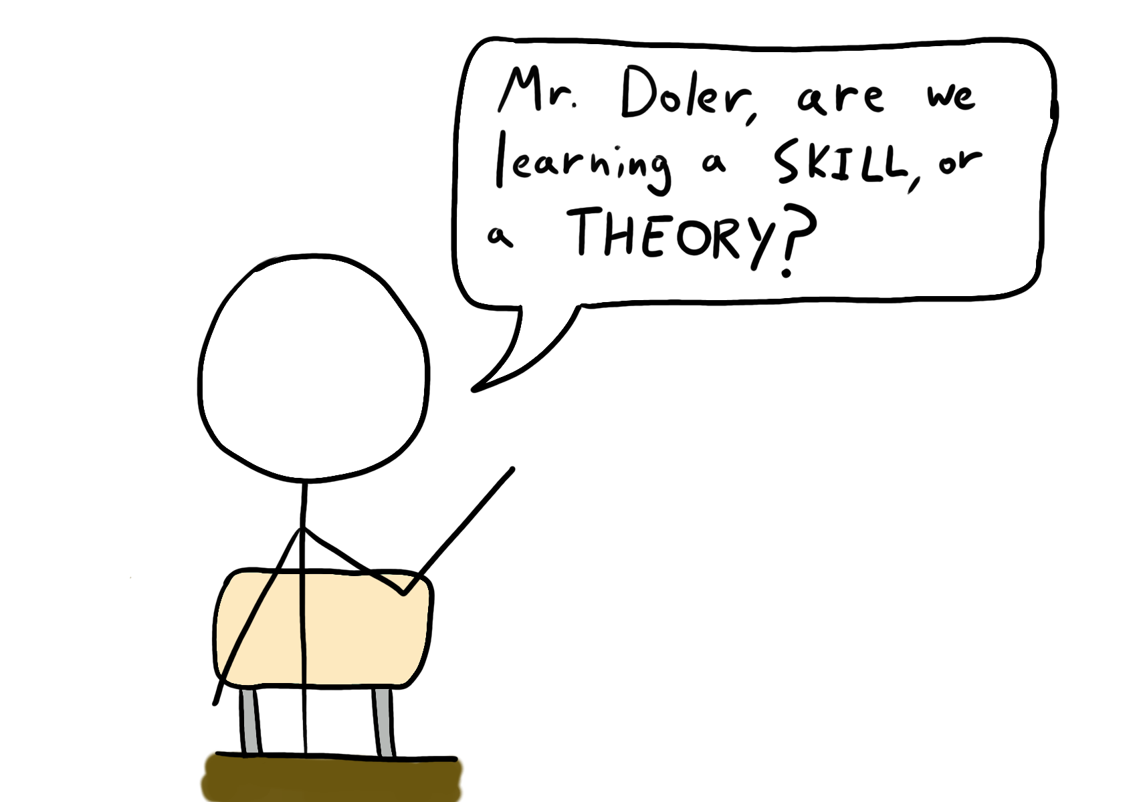

Slide 21
Really, they’re kind of the same thing…

Slide 22
Theory of Action
A set of assumptions we have and actions we can perform in order to achieve a goal
Argyris and Schön, Theory in Practice, 1974

Slide 23
Governing Variables
The constraints we operate under when using our theory of action
Argyris and Schön, Theory in Practice, 1974

Slide 24
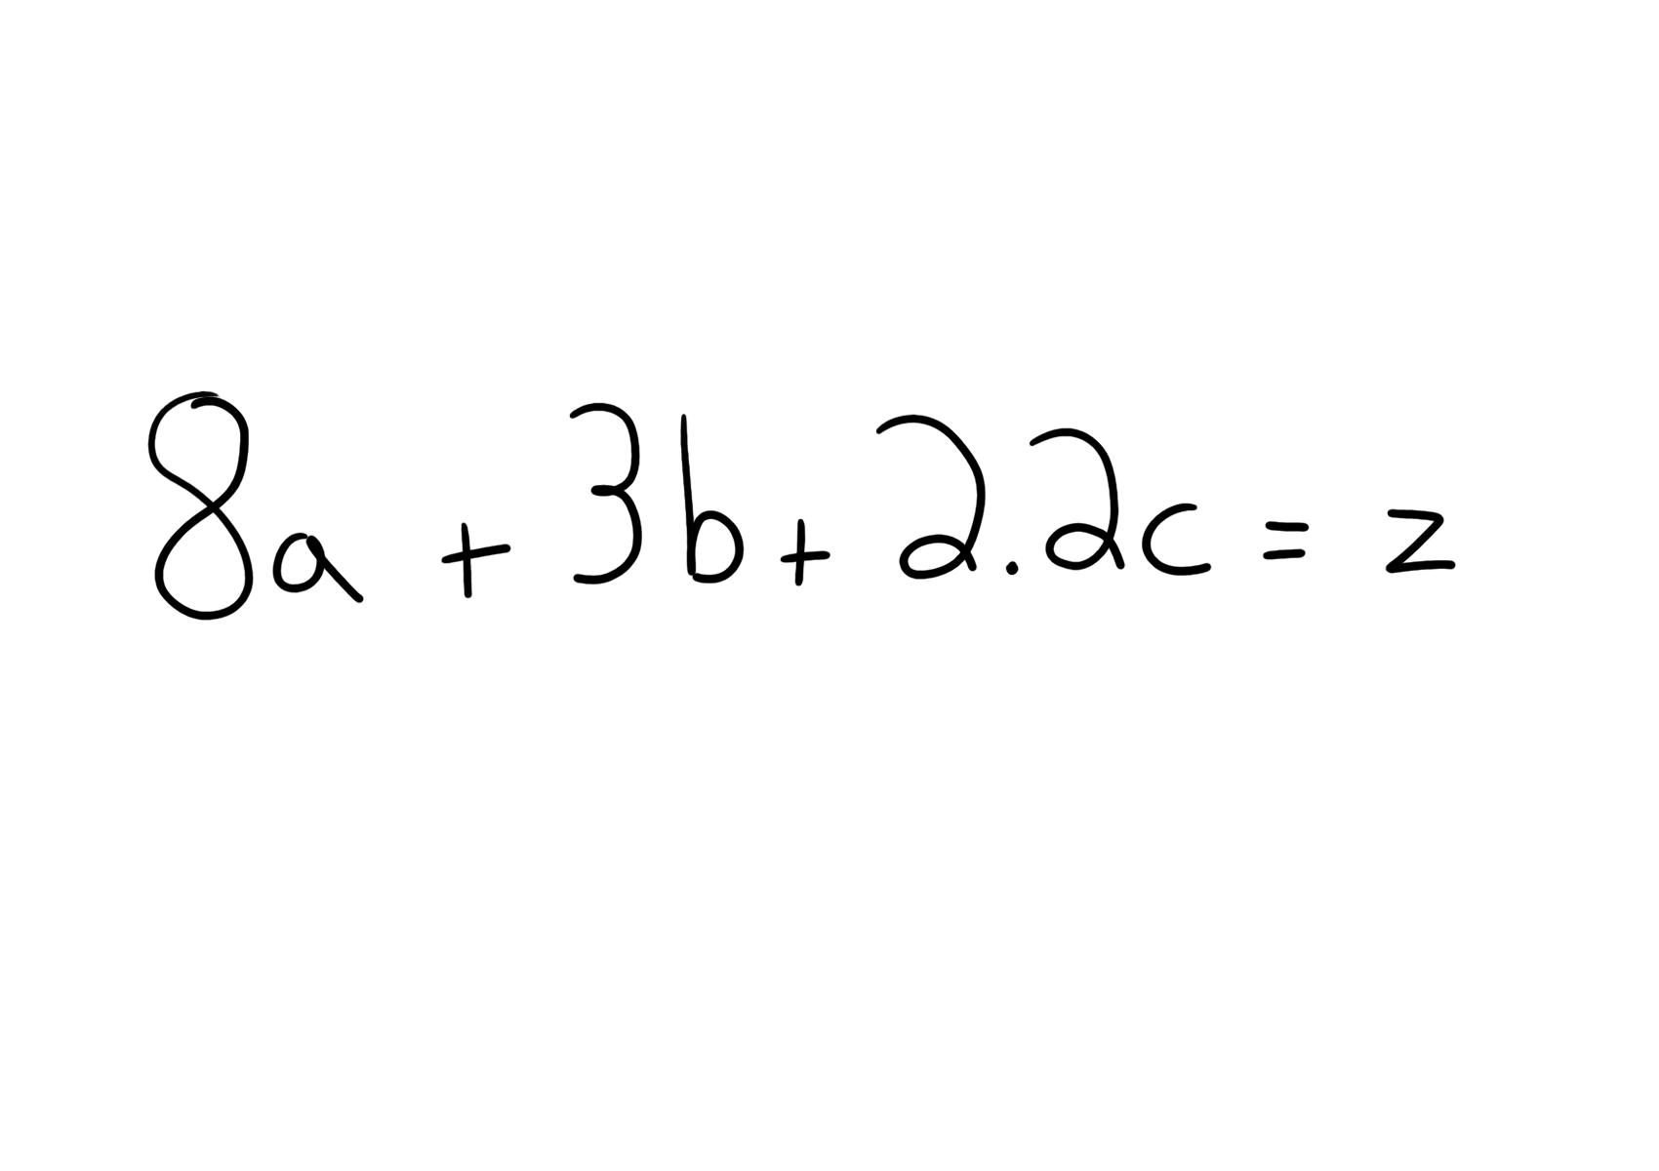
Notes:
THIS IS A STATEMENT OF BELIEF

Slide 25
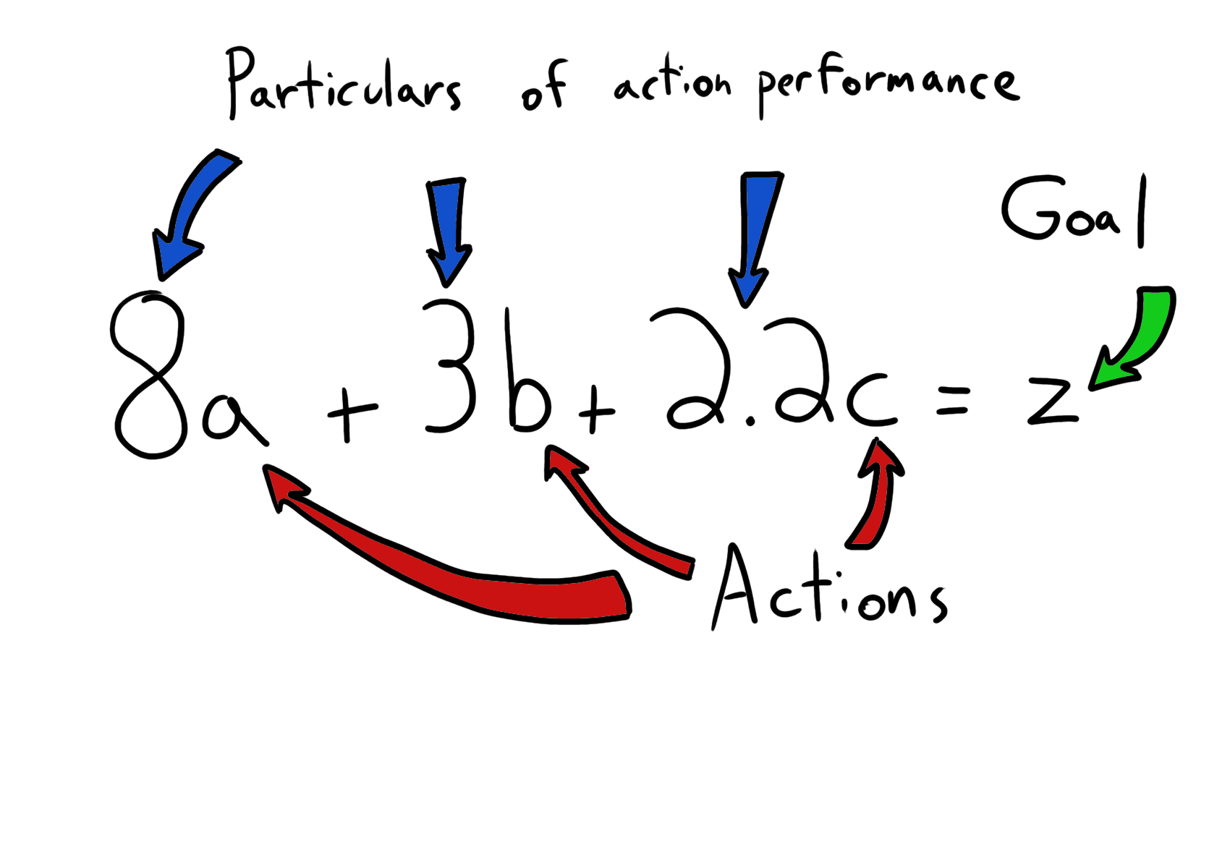

Slide 26
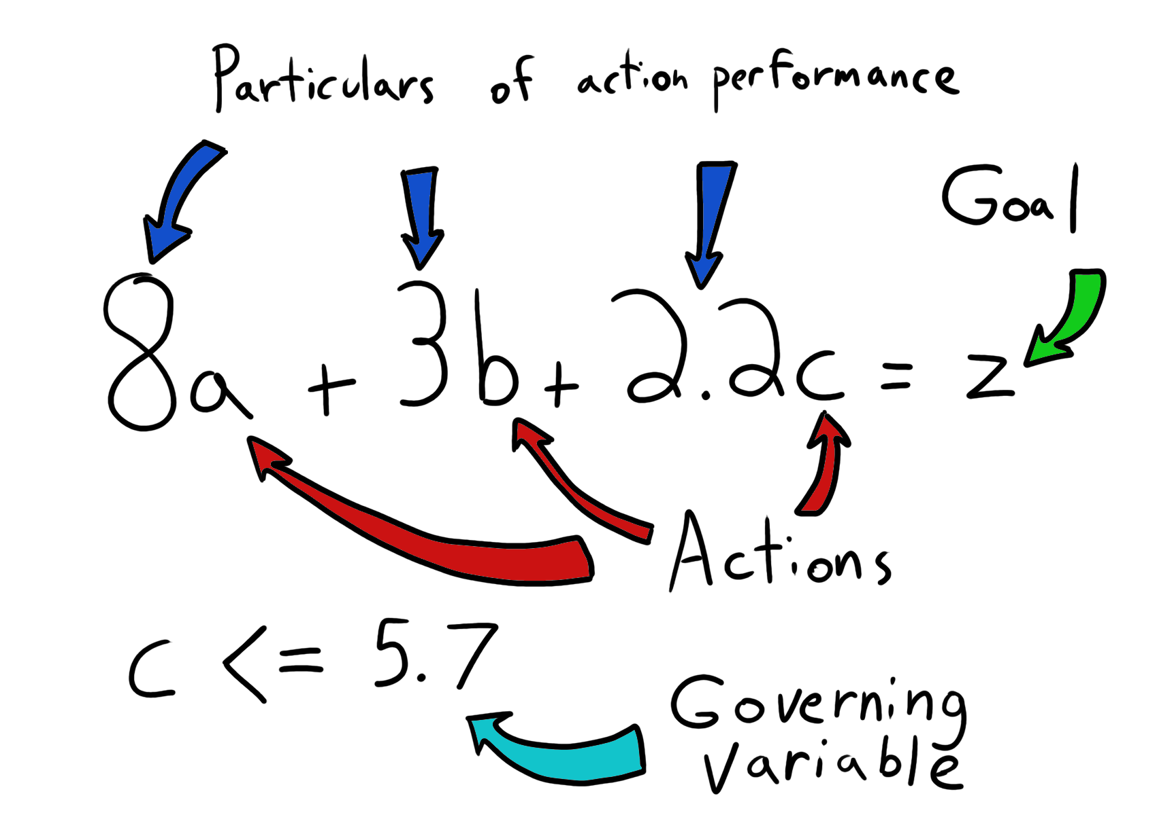

Slide 27
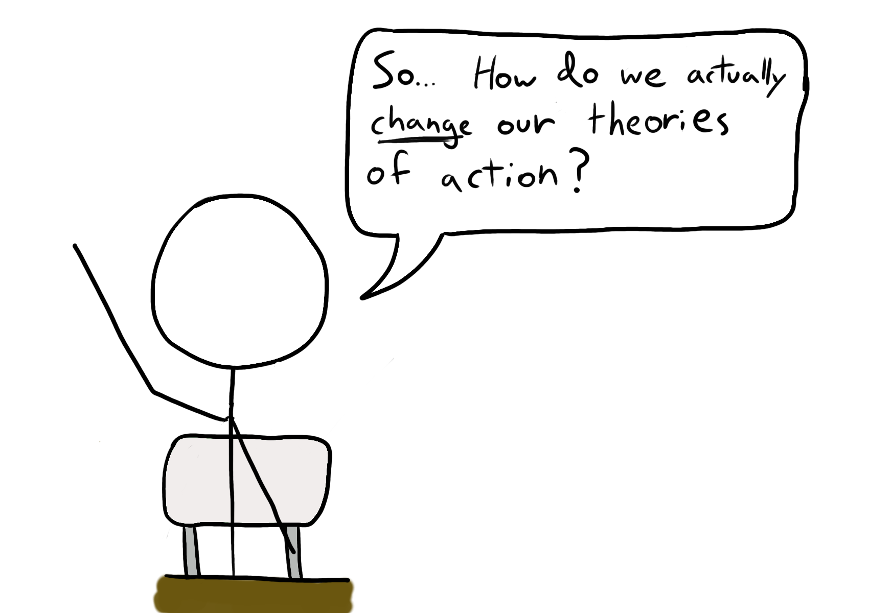

Slide 28
We change our theories of action in two ways:

Slide 29
Slight improvements as we learn through implicit memory, neuroplasticity, and myelination

Slide 30
HUGE, conscious changes brought on by dilemmas we face due to our theories that require us to cognitively engage

Slide 31
A Few Examples

Slide 32
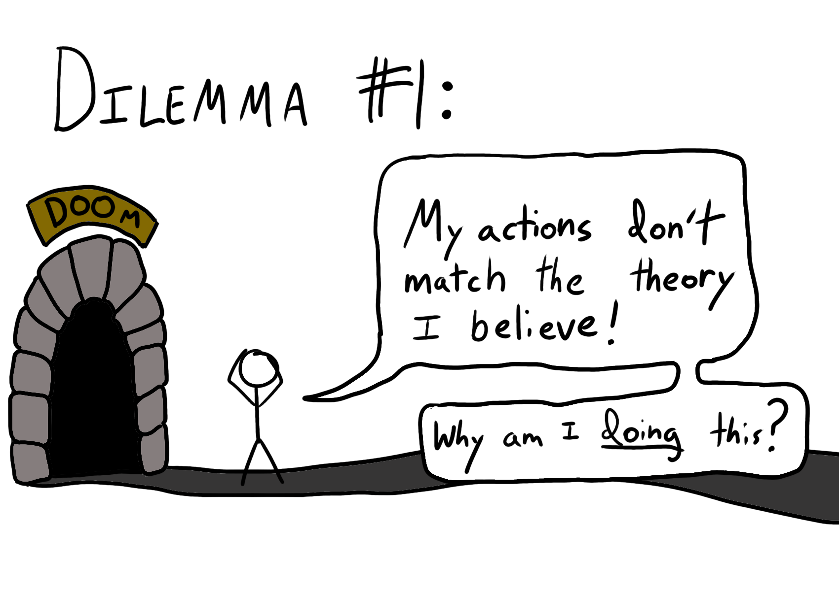

Slide 33
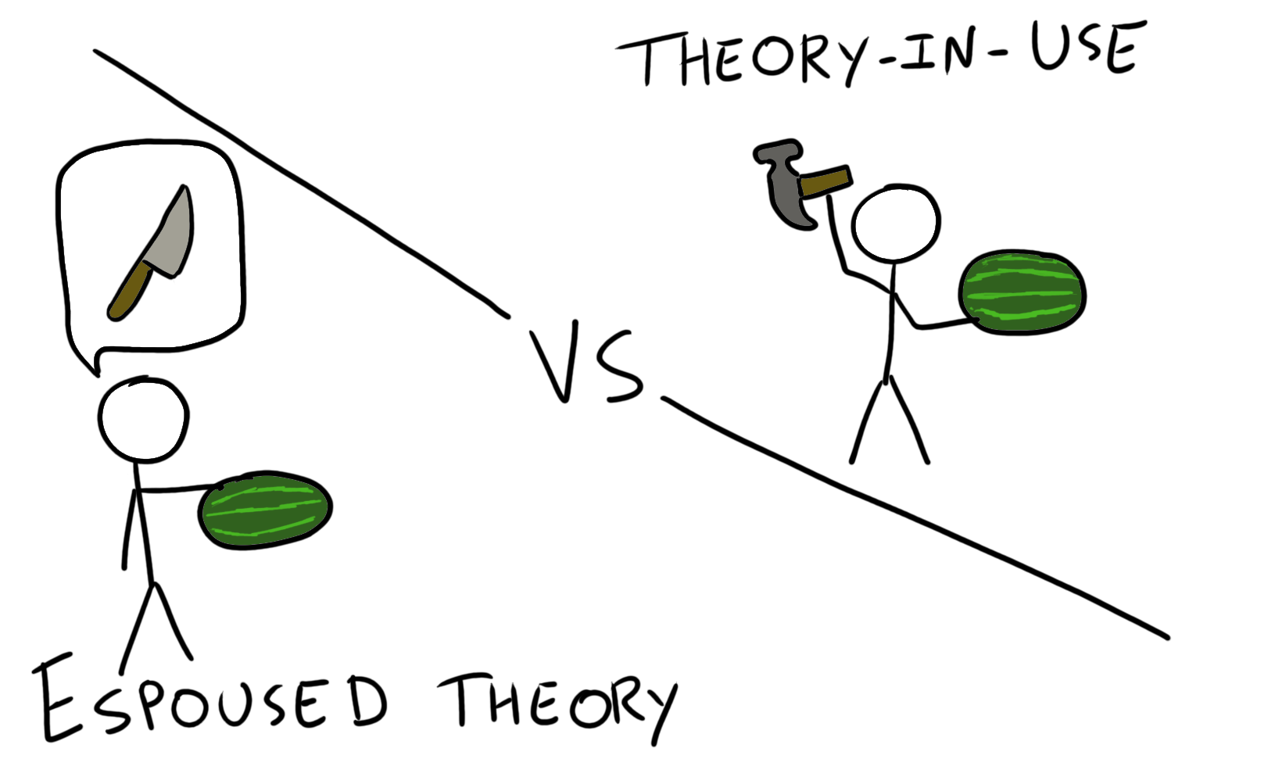

Slide 34
Why would they be different?

Slide 35
Lying about their espoused theory
Cognitive biases and tacit knowledge
Desire for cognitive ease
Cognitive dissonance
The list goes on…

Slide 36
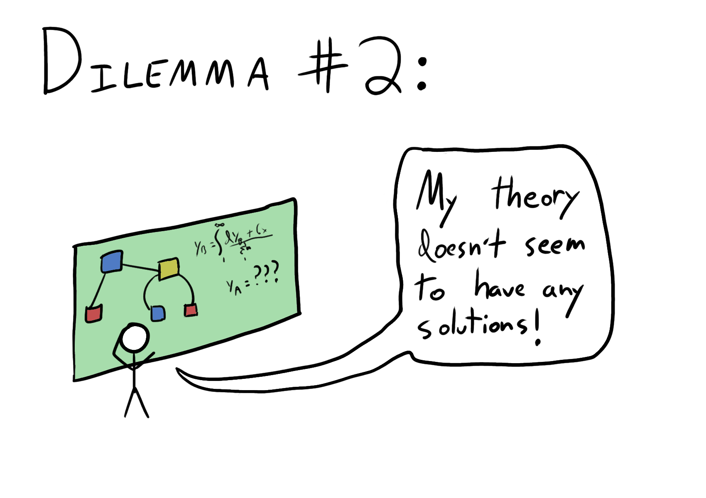
Notes:
Governing variables are incompatible – e.g. can’t make your boss happy AND your team happy

Slide 37
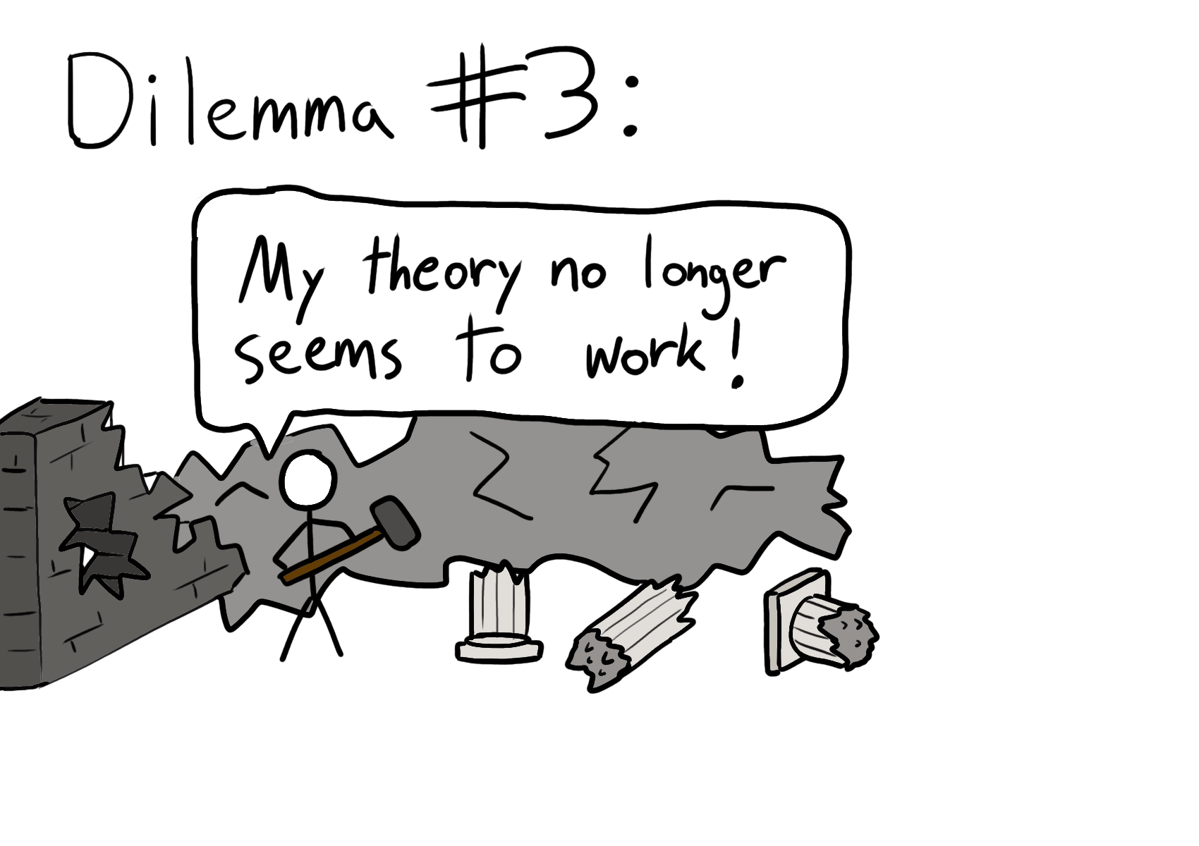
Notes:
Governing variables no longer satisfiable bc our actions have changed the environment so much

Slide 38
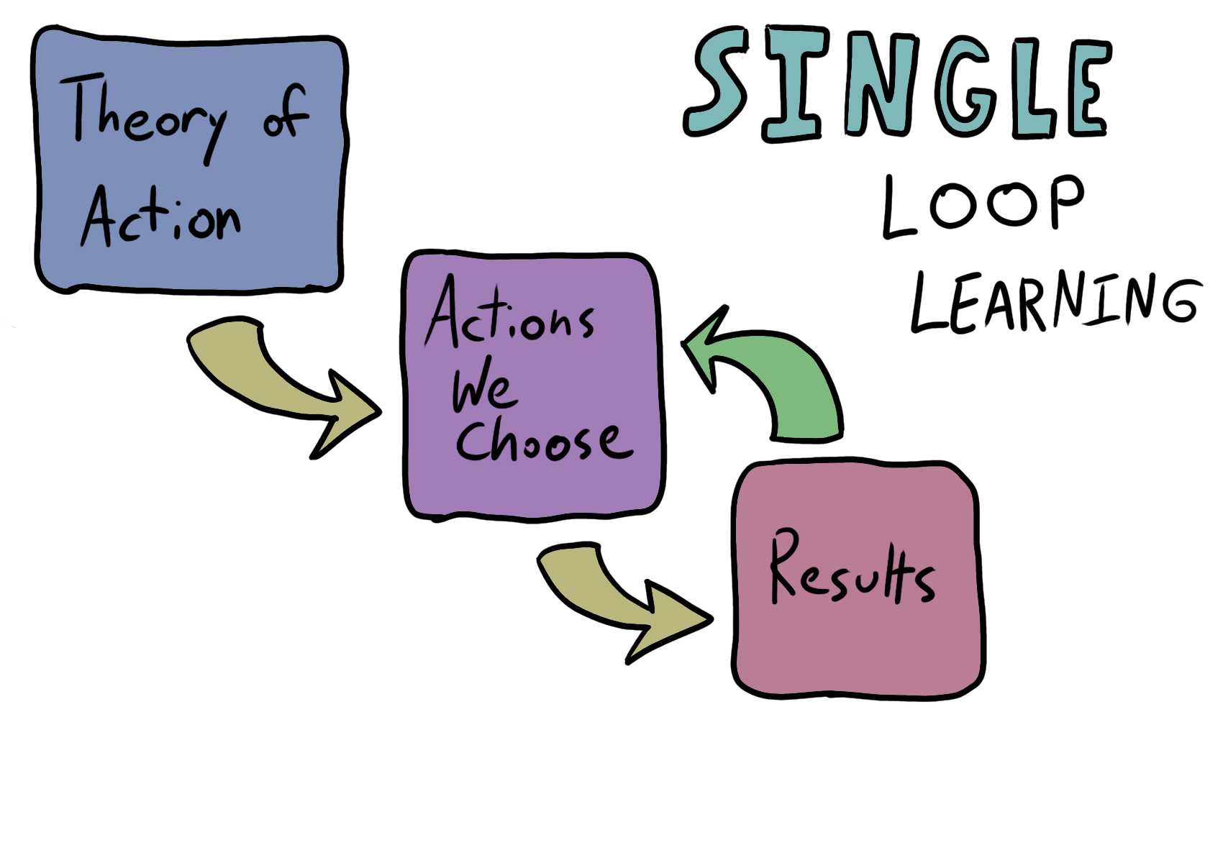

Slide 39
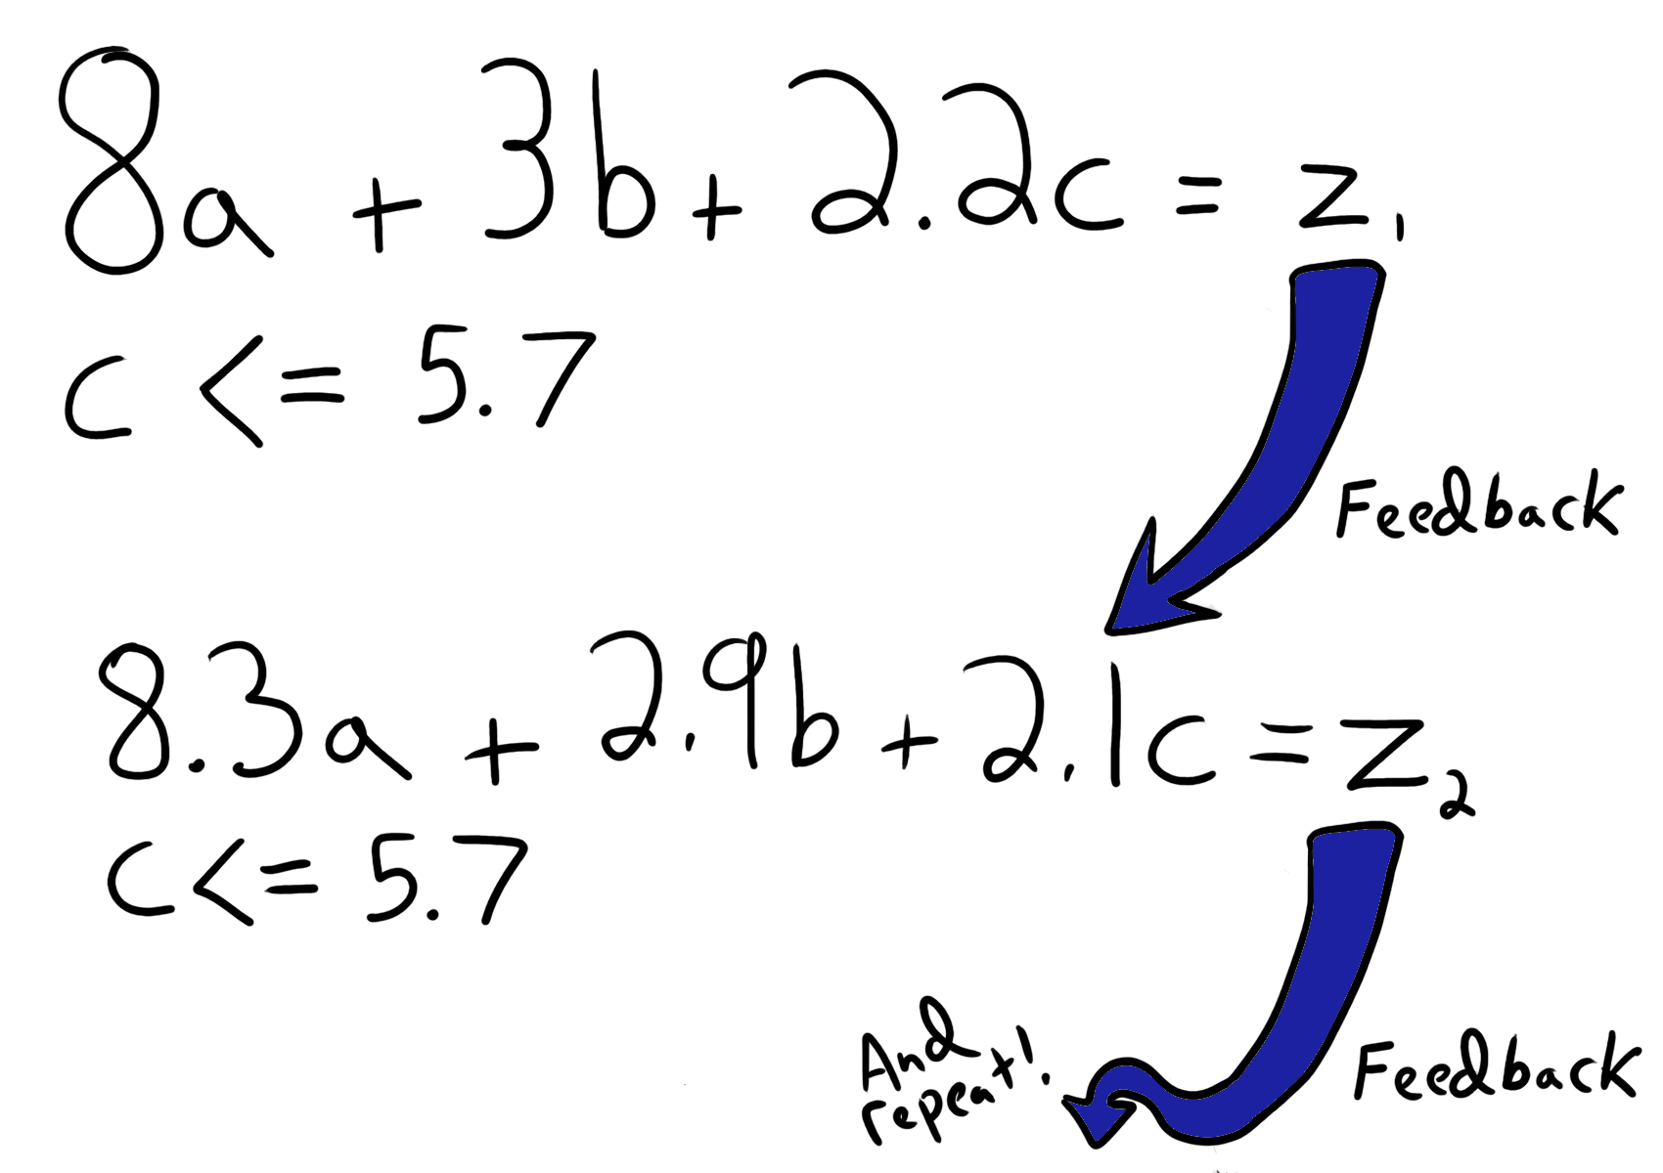
Notes:
Changing our theories in a continuous manner via implicit/tacit experience is single loop learning

Slide 40
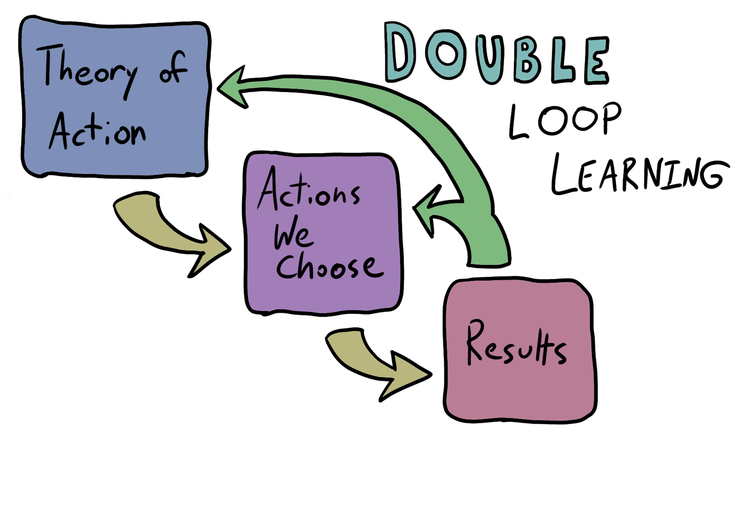

Slide 41
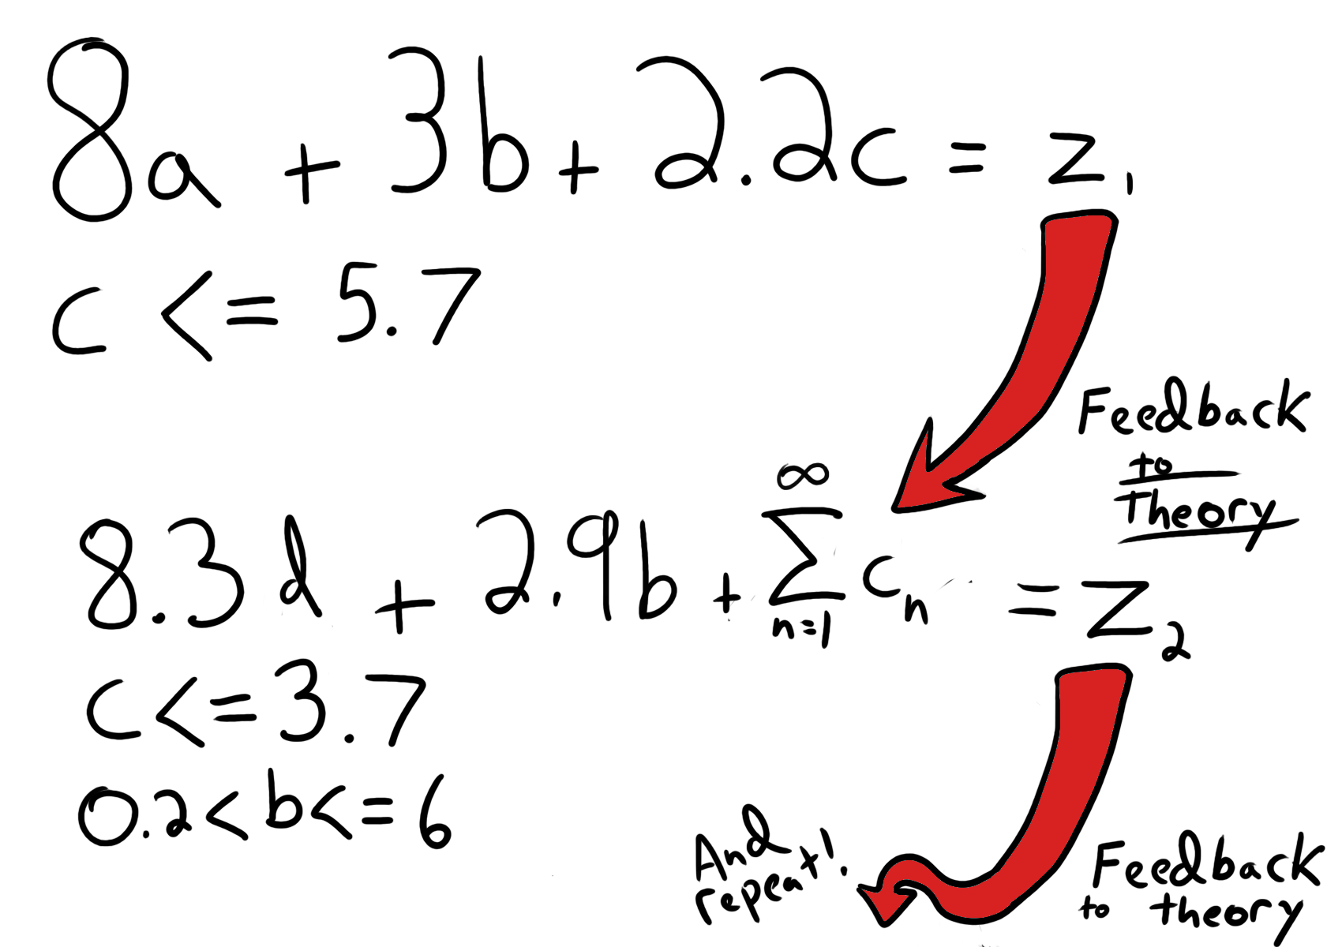
Notes:
Changing our theories in a discontinuous & abrupt manner via explicit knowledge is double loop learning

Slide 42
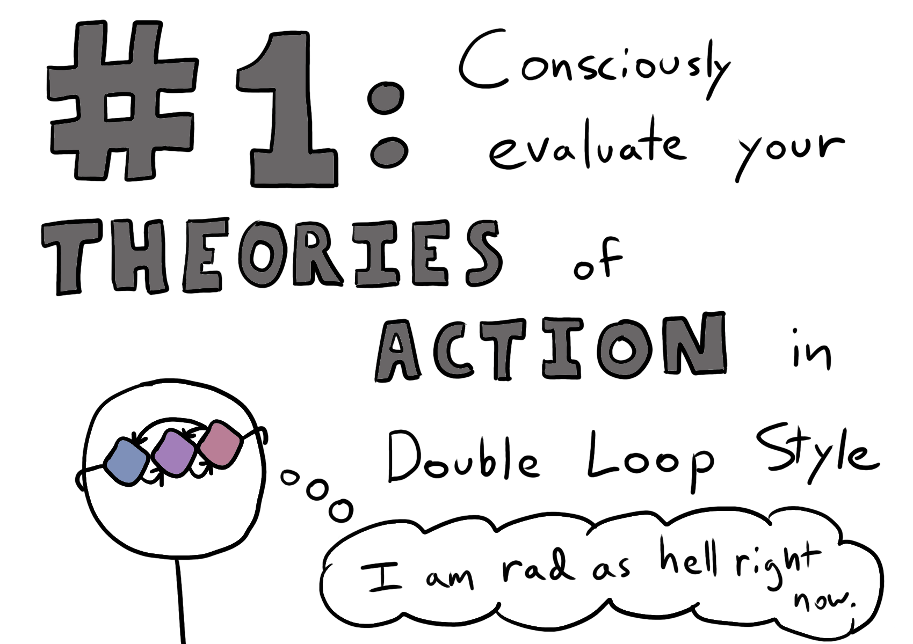

Slide 43
Be able to describe your theories
Try things that will disprove your assumptions (if you can)
Go TDD-style when building a theory

Slide 44
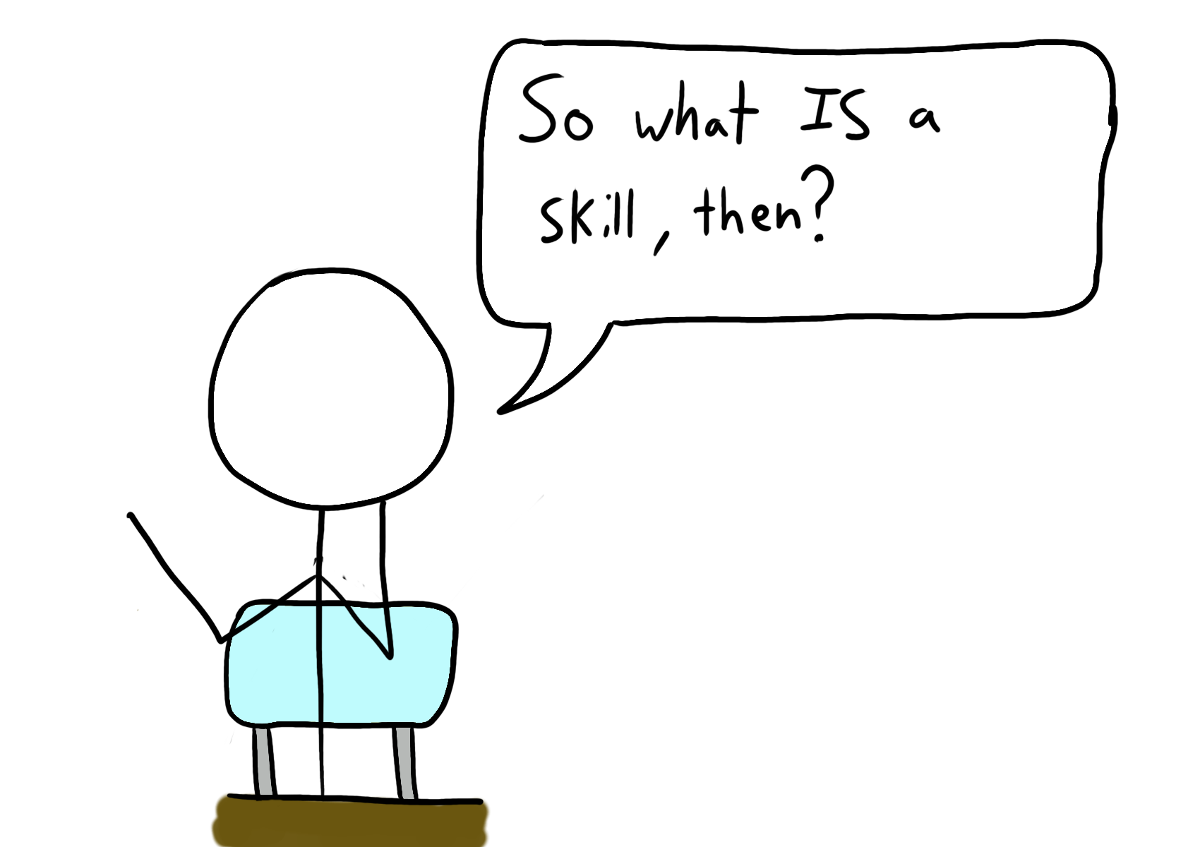

Slide 45
Skill
A measure of your ability to behave effectively in situations of action
Argyris and Schön, Theory in Practice, 1974

Slide 46
What matters more is whether the knowledge is: explicit implicit or tacit

Slide 47
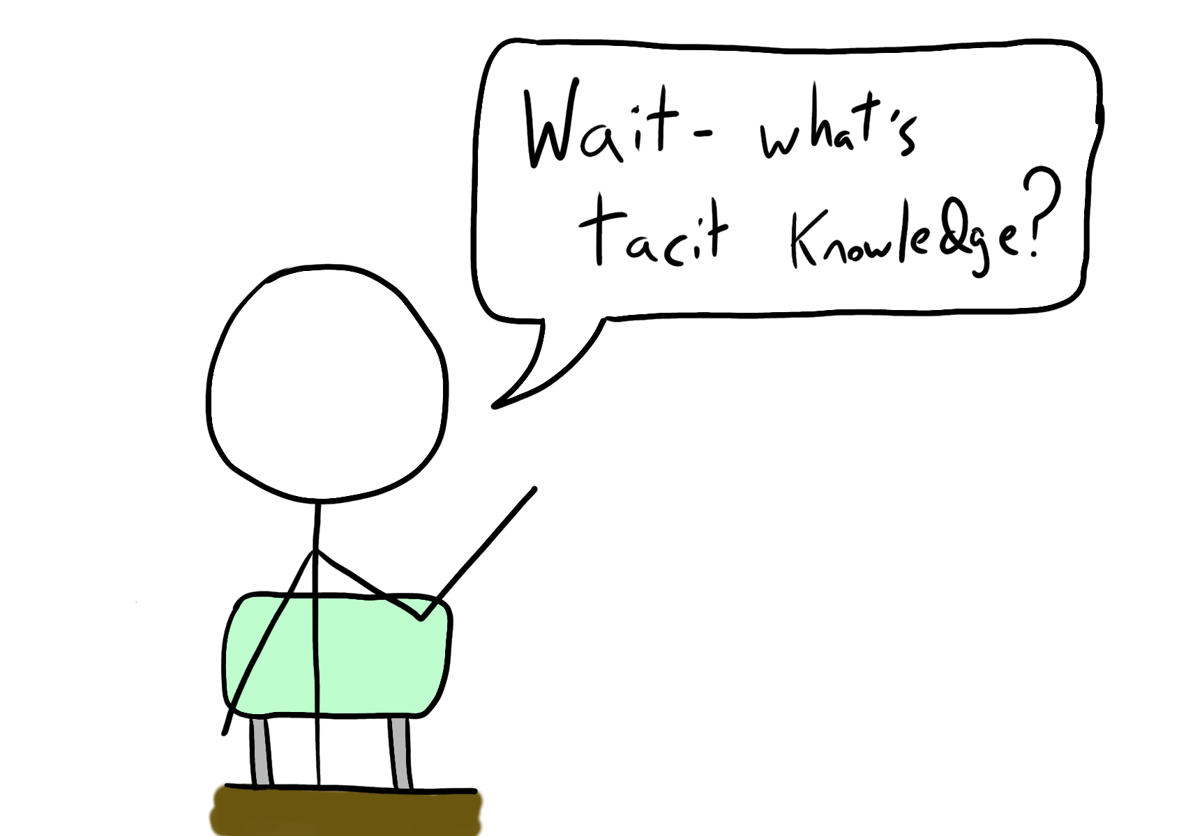

Slide 48
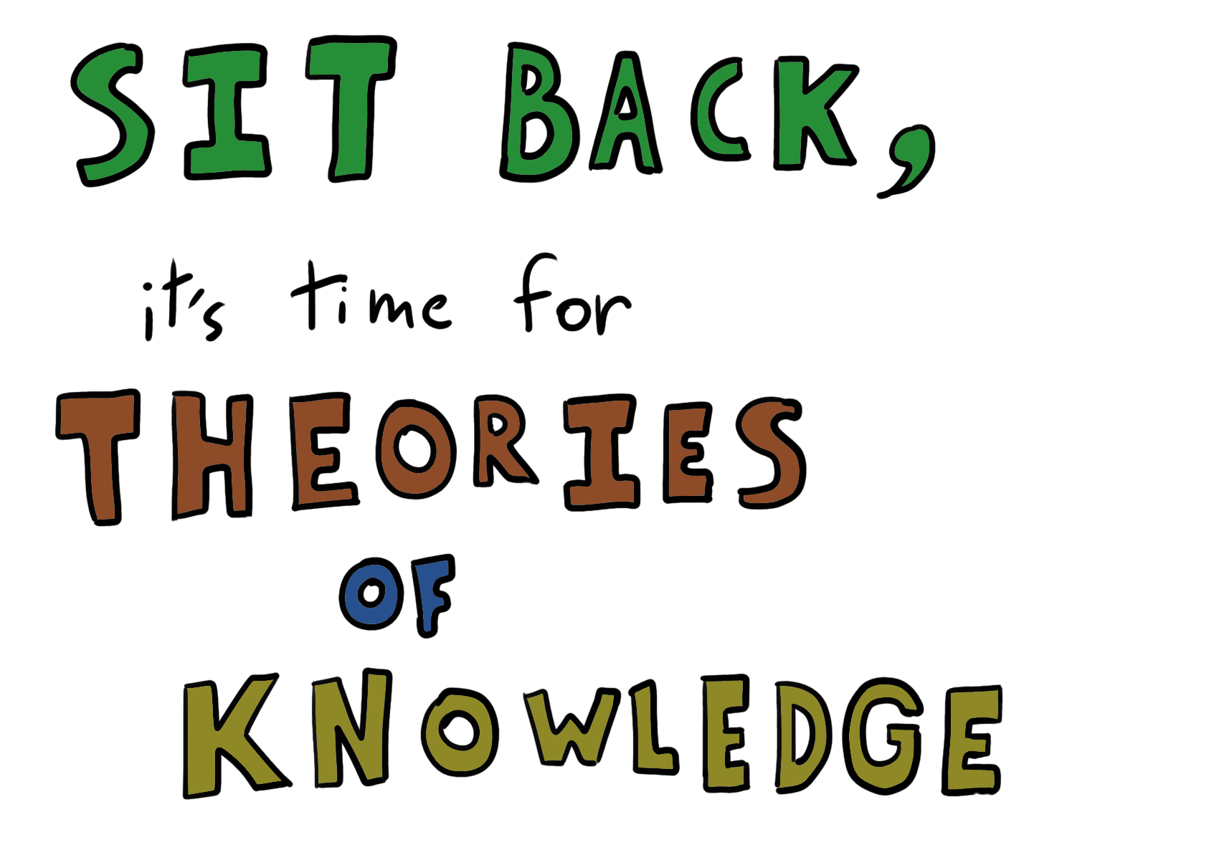

Slide 49
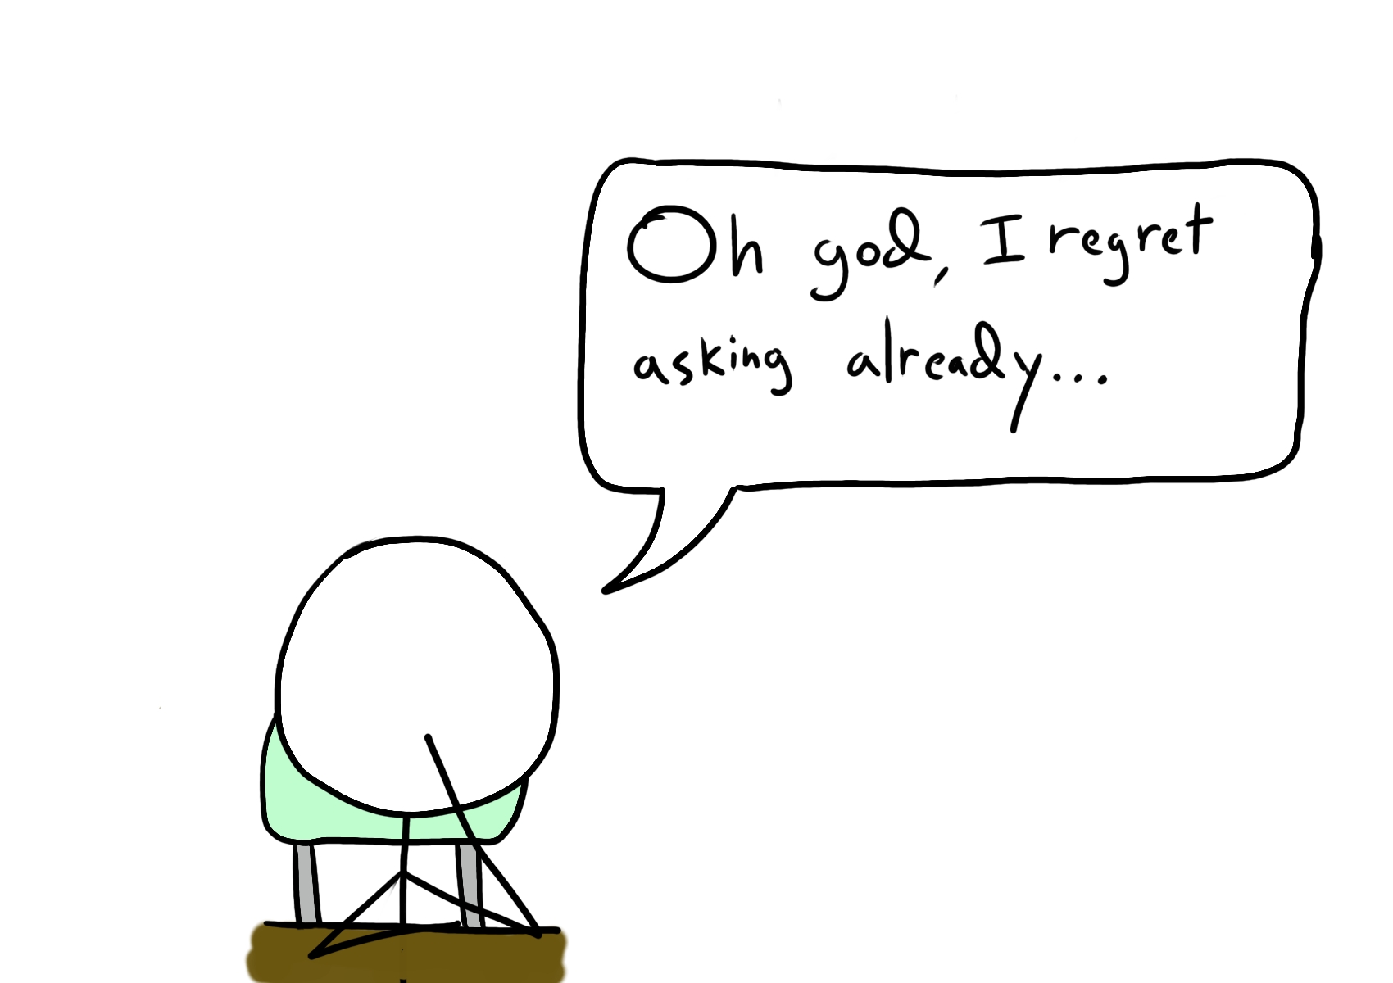

Slide 50
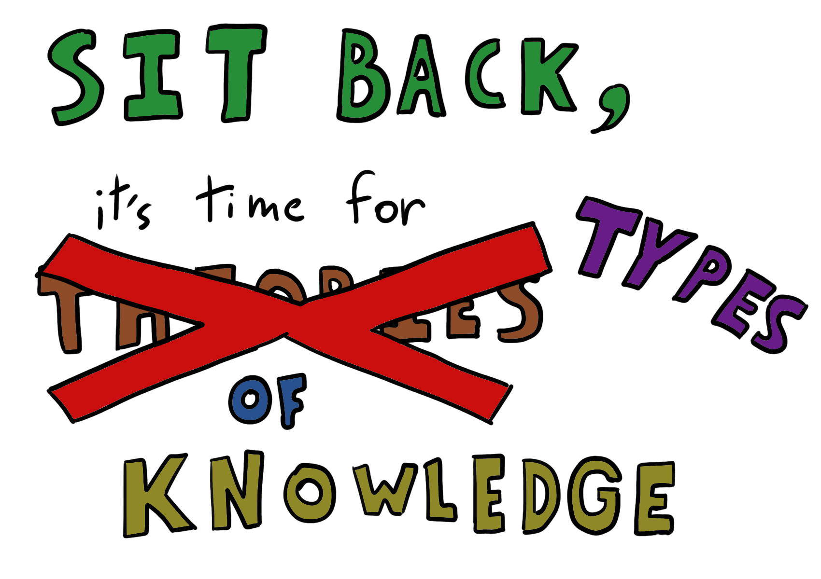

Slide 51
Explicit knowledge
Knowledge that can be readily articulated, codified, accessed and verbalized
Hélie & Sun, 2010

Slide 52
Tacit Knowledge
Knowledge that cannot be articulated or codified but instead can only be gained through experience or watching someone perform a task
Polanyi, Personal Knowledge, 1958
Notes:
Michael Polanyi in 1958 in Personal Knowledge, Polanyi, Michael (1966), The Tacit Dimension

Slide 53
Implicit Knowledge
Knowledge that is not explicit, but could be articulated and codified with effort
Nonaka & Takeuchi, 1995

Slide 54
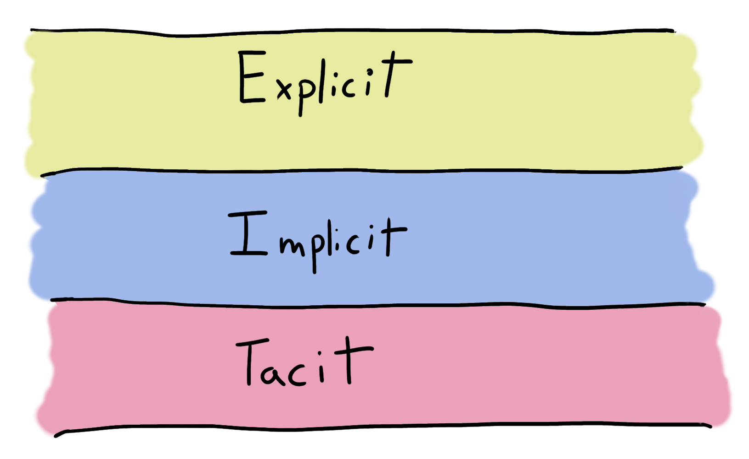

Slide 55
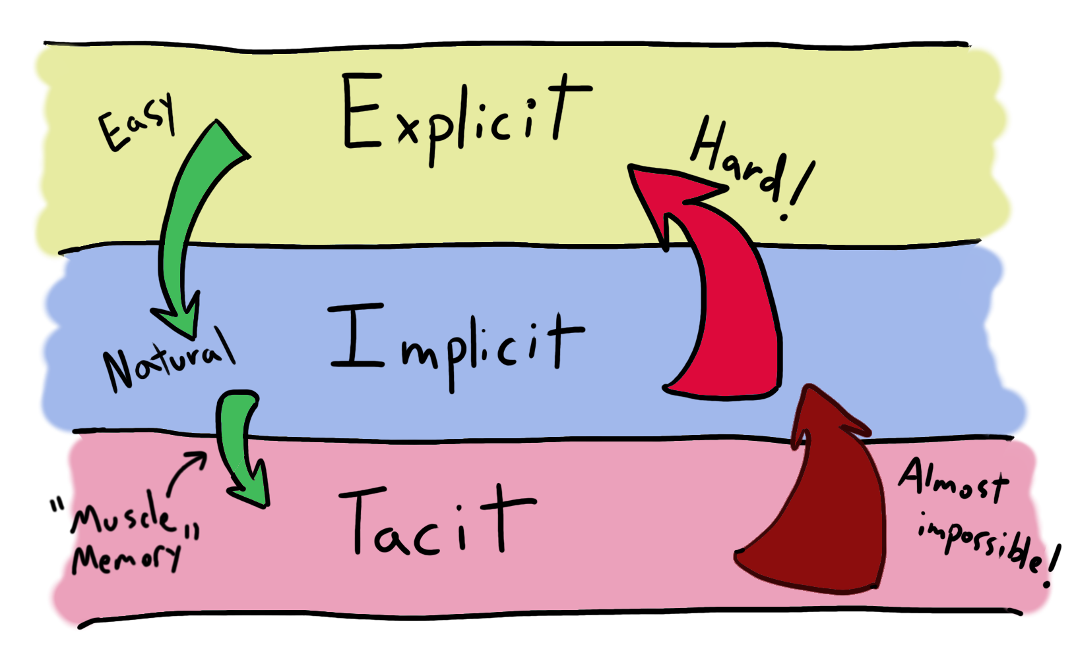
Notes:
ADD MUSCLE MEMORY

Slide 56
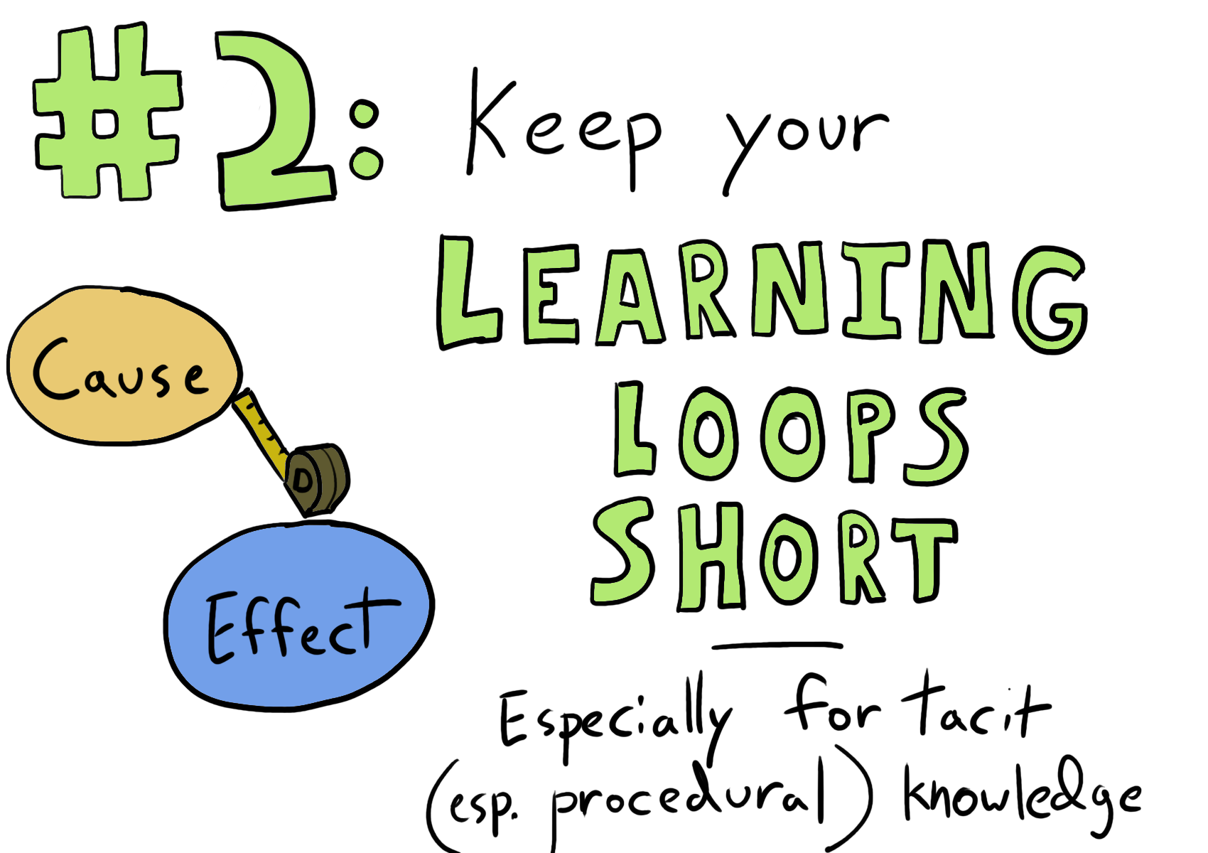

Slide 57
Build times & unit test times
Time to get peer review results
Try some katas to get quick coding feedback
Limiting WIP keeps your loops shorter by default

Slide 58
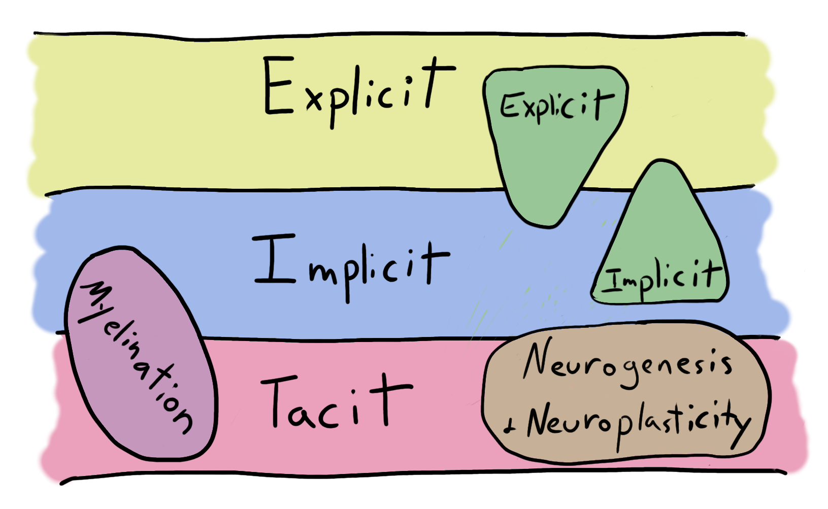
Notes:
Neuroplasticity/neurogenesis

Slide 59
Explicit Memory

Slide 60
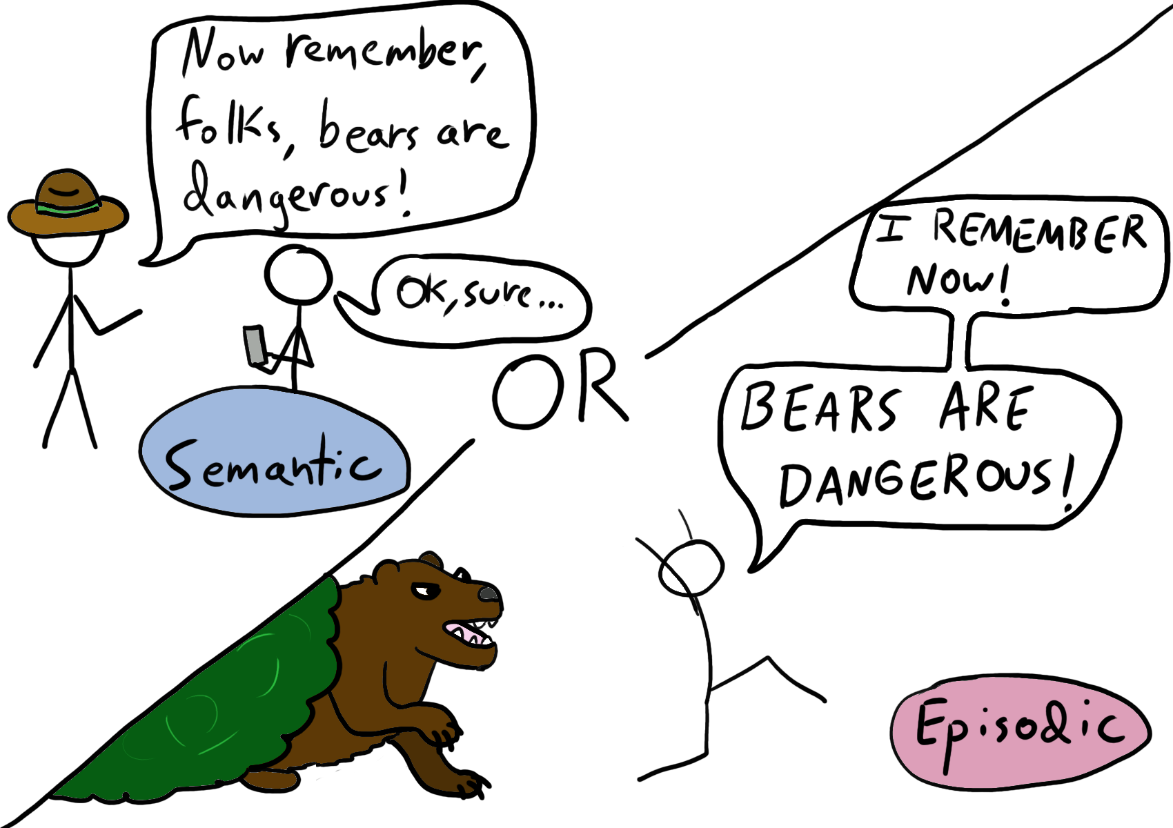
Notes:
Mention Network/Associative models

Slide 61
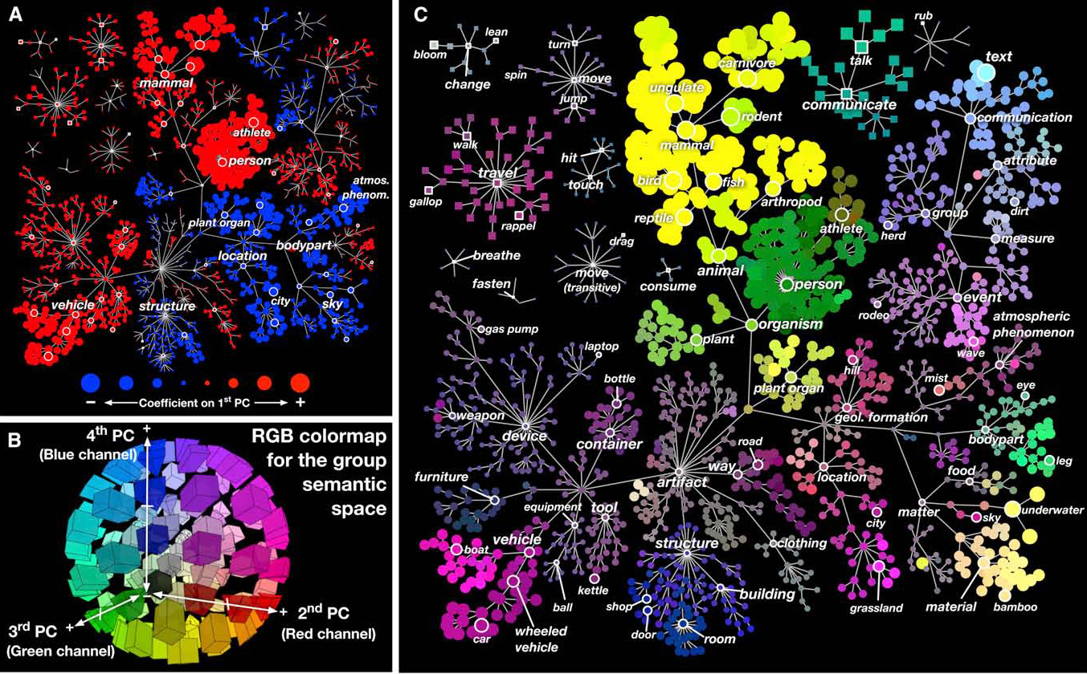
Notes:
Explicit memory is associative/networked – exploring semantic web by reaction time from primed concepts

Slide 62
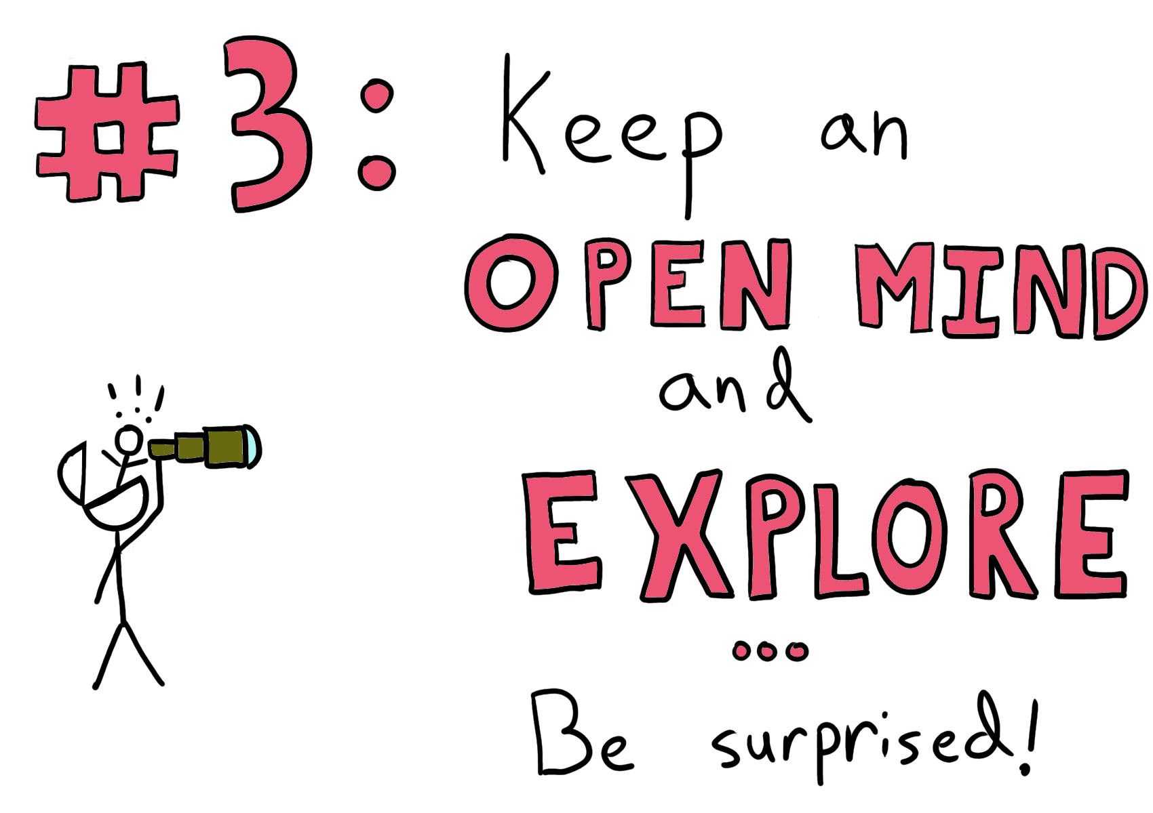

Slide 63
Set up experiments:
Form hypotheses about why something is the way it is – then go try to disprove them
Allow yourself to go on explorative tangents
Budget time for curiosity

Slide 64
Implicit Memory

Slide 65
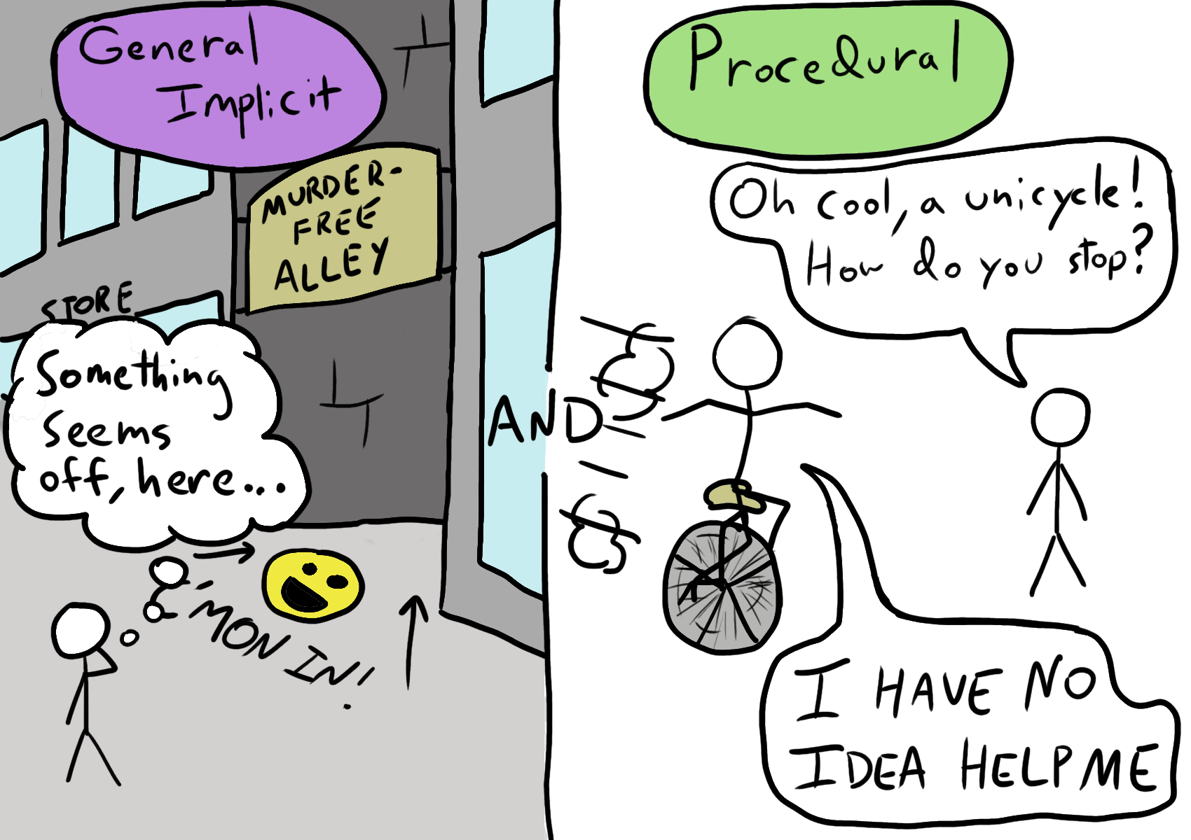
Notes:
UNCONSCIOUS recollection of memory
Procedural

Slide 66
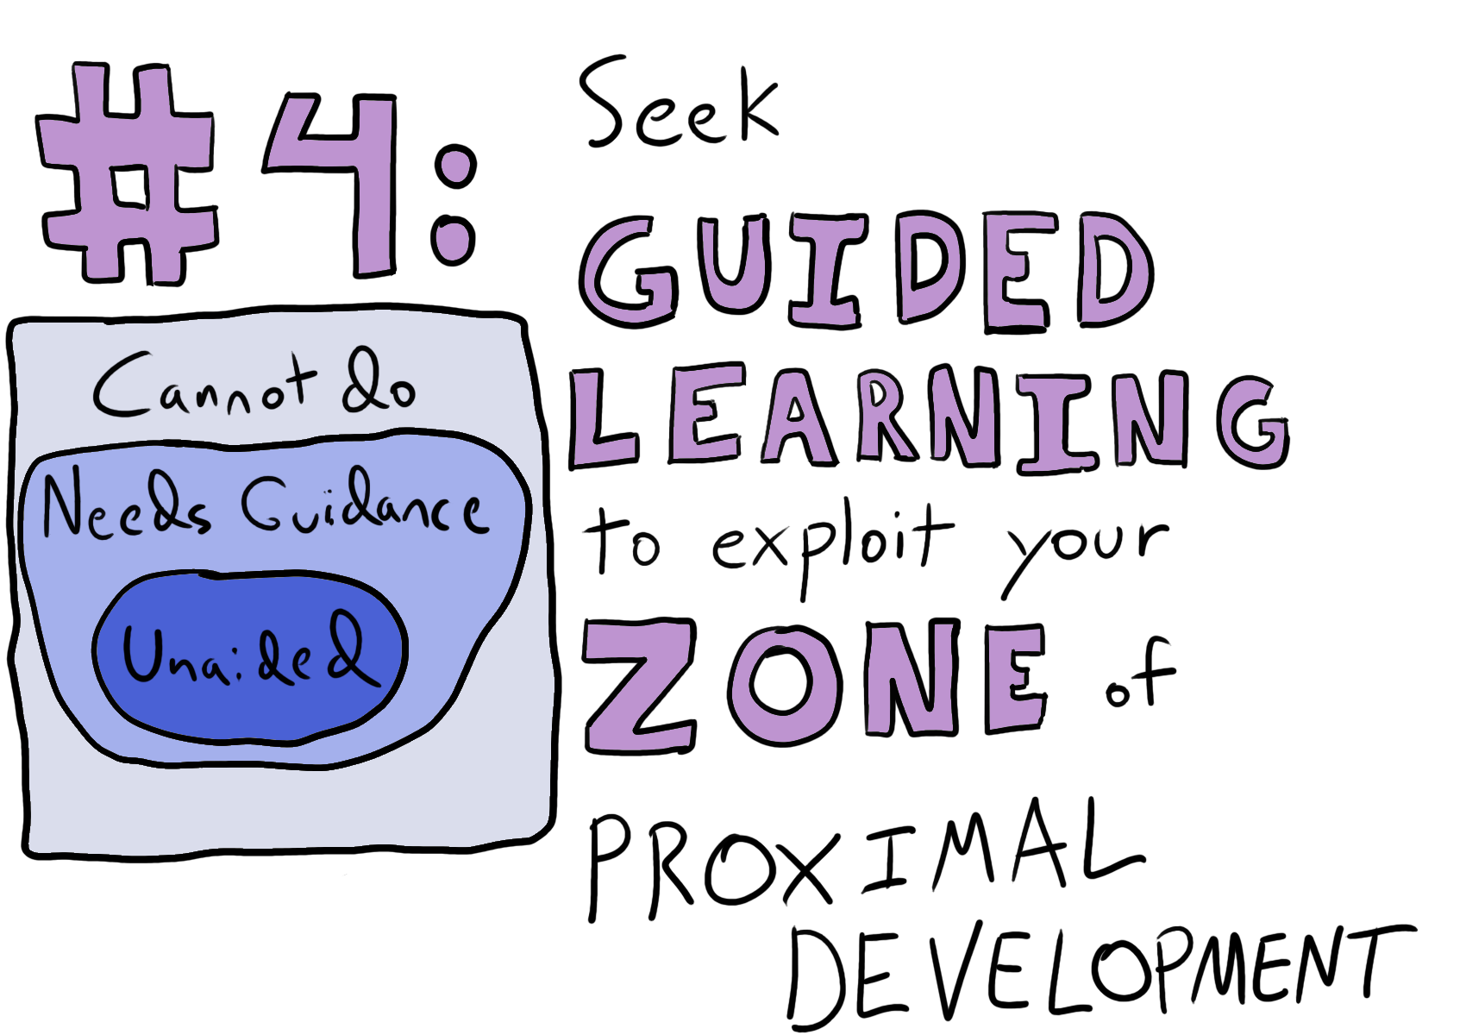

Slide 67
Find a mentor
Or a digital mentor
Or buy a mentor
Listen to other people
Watch other’s PRs or have group PRs
Be mindful & listen to your implicit memory

Slide 68
Myelination

Slide 69
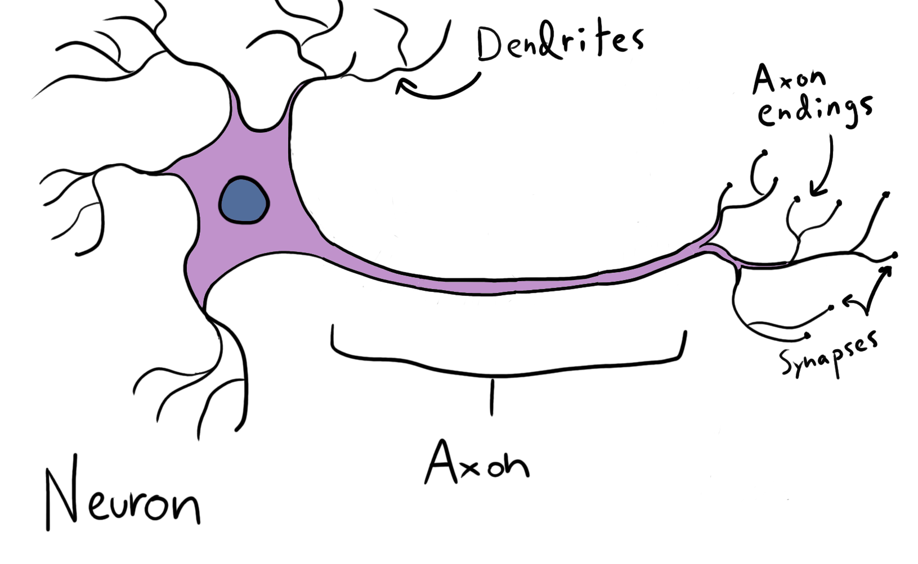
From, Eilam, Bar-Lev, Levin-Zaidman, Tsoory, LoPresti, Sela, Arnon, and Aharoni, 2014 Zalc and Fields, 2000

Slide 70
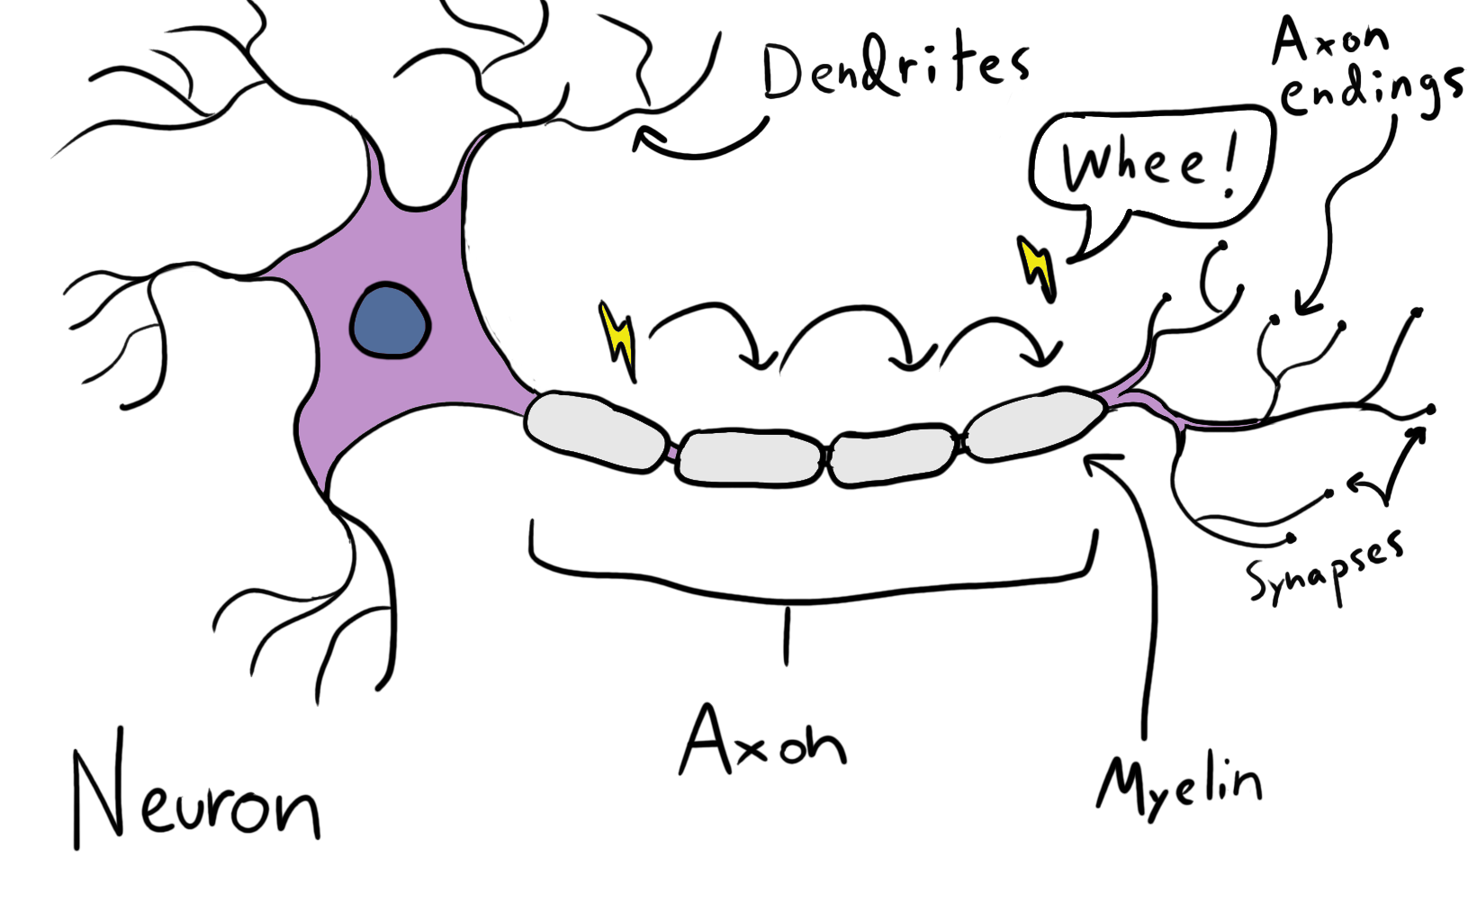
From, Eilam, Bar-Lev, Levin-Zaidman, Tsoory, LoPresti, Sela, Arnon, and Aharoni, 2014 Zalc and Fields, 2000
Notes:
Myelin coats neuronal axons
In the CNS AND in other nerves
“Under a microscope, myelin looks like strings of sausages.”
Thought to be triggered from action potentials (sign that nerve gets used)

Slide 71
Neuroplasticity & Neurogenesis

Slide 72
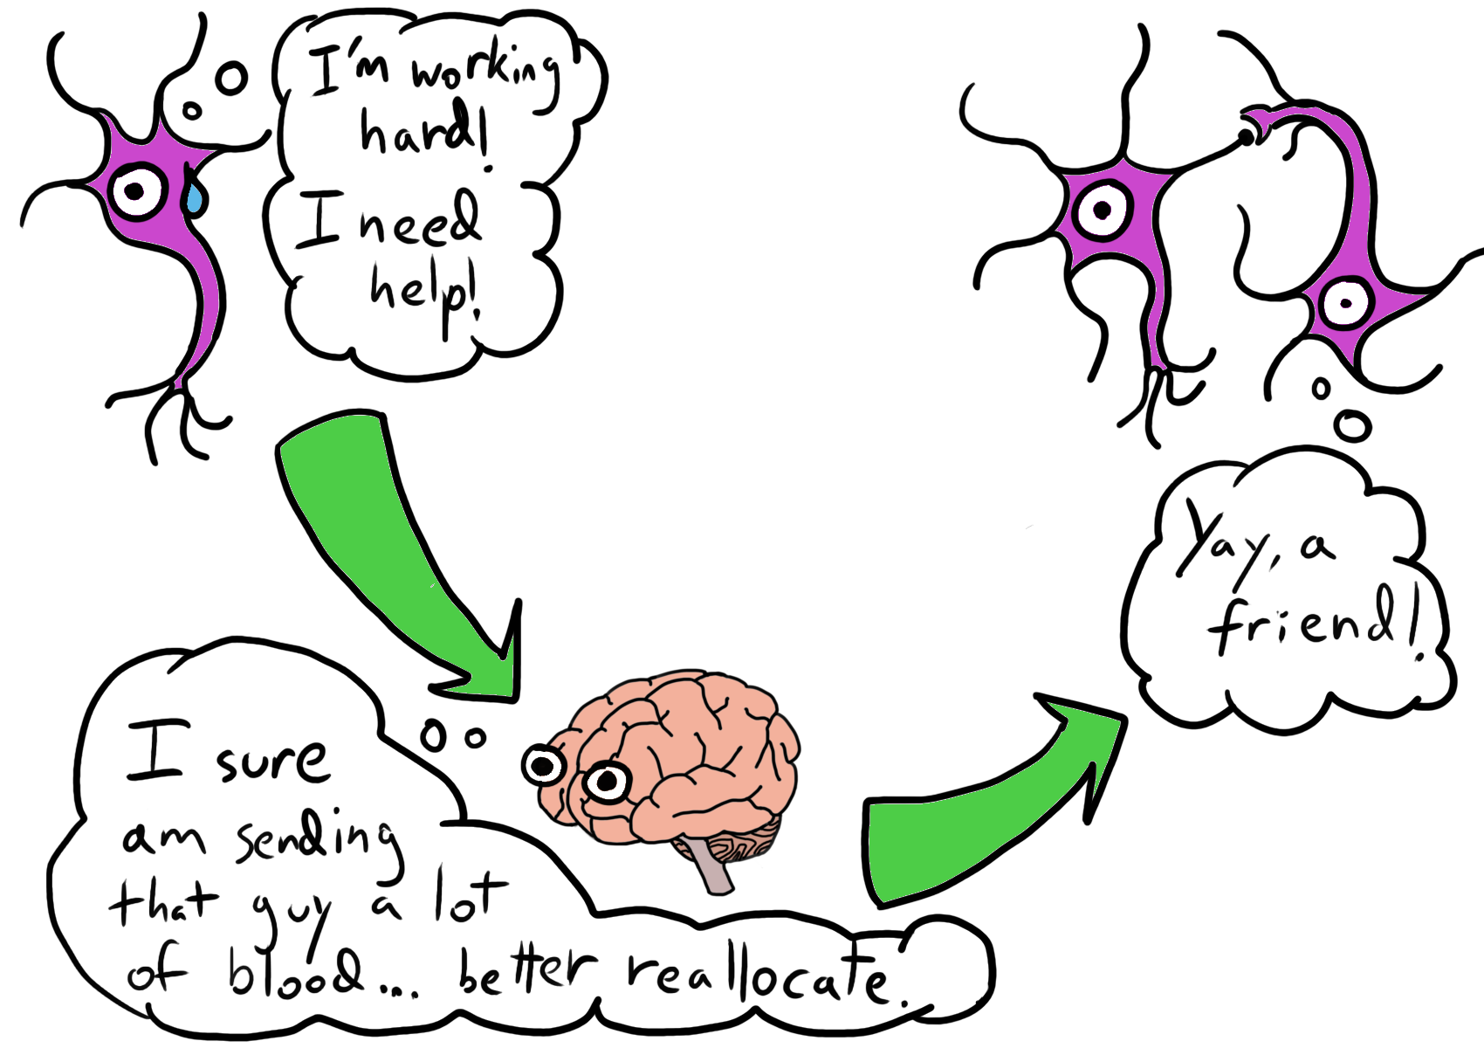
Notes:
Brain is “plastic” (can be changed) into adulthood
Activity-Dependent is a form that builds neurons where we use the most blood

Slide 73
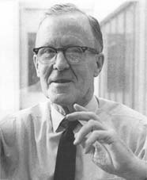
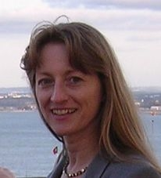
“Neurons that fire together, wire together. Neurons that fire out of sync, fail to link.” – Siegrid Löwel’s summary of Hebbian Theory
Image Sources: Canadian Society for Brain, Behaviour and Cognitive Science (CSBBCS) (https://www.csbbcs.org/images/donald_hebb.jpg) Georg-August University of Göttingen (https://www.uni-goettingen.de/admin/bilder/pictures/1070d7880621130dd098fe388aab9259.jpg)

Slide 74
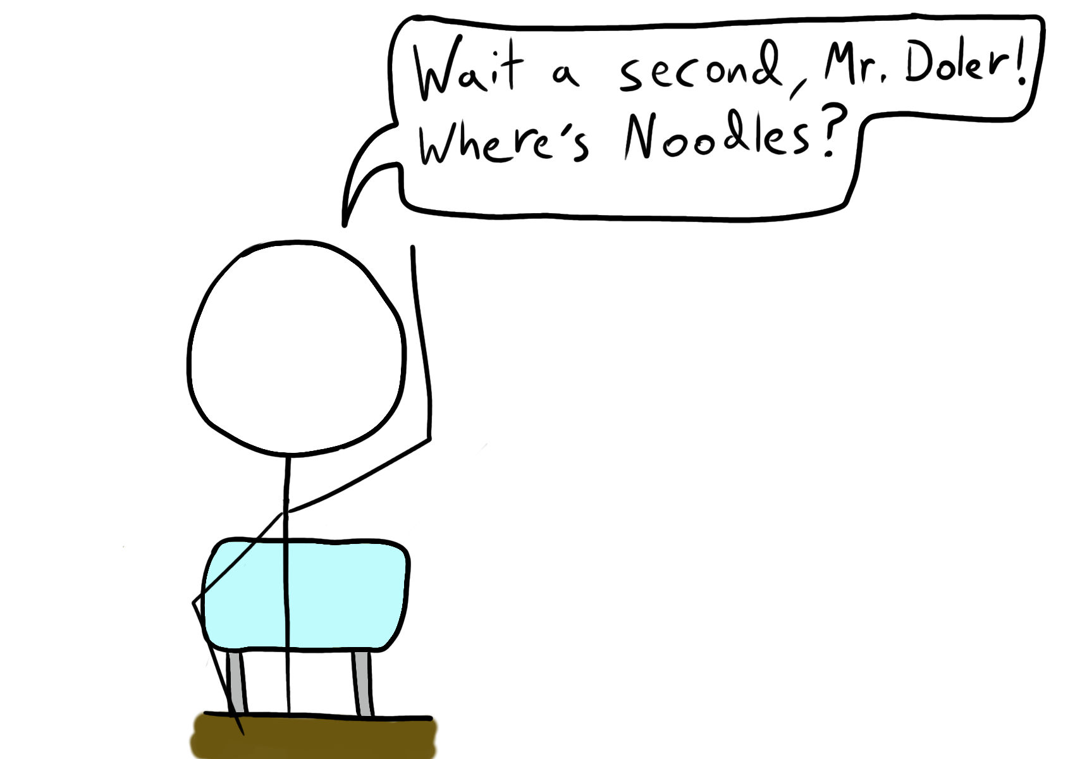

Slide 75
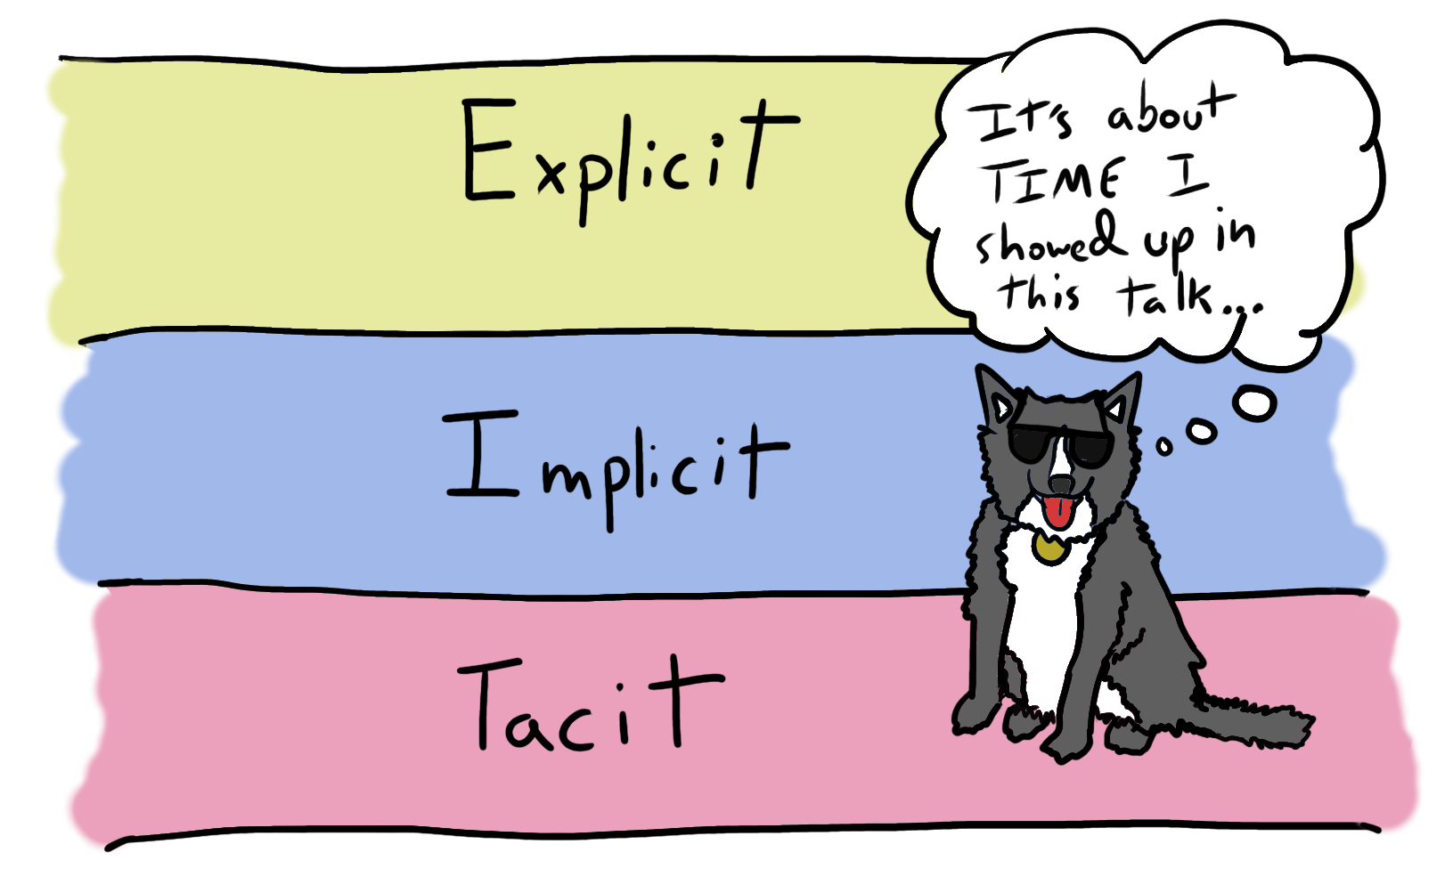
Notes:
Noodles lives in the bottom 2 because they’re part of system 1

Slide 76
System 1 is often what learns

Slide 77
But almost all learning requires us to use System 2 at some point

Slide 78
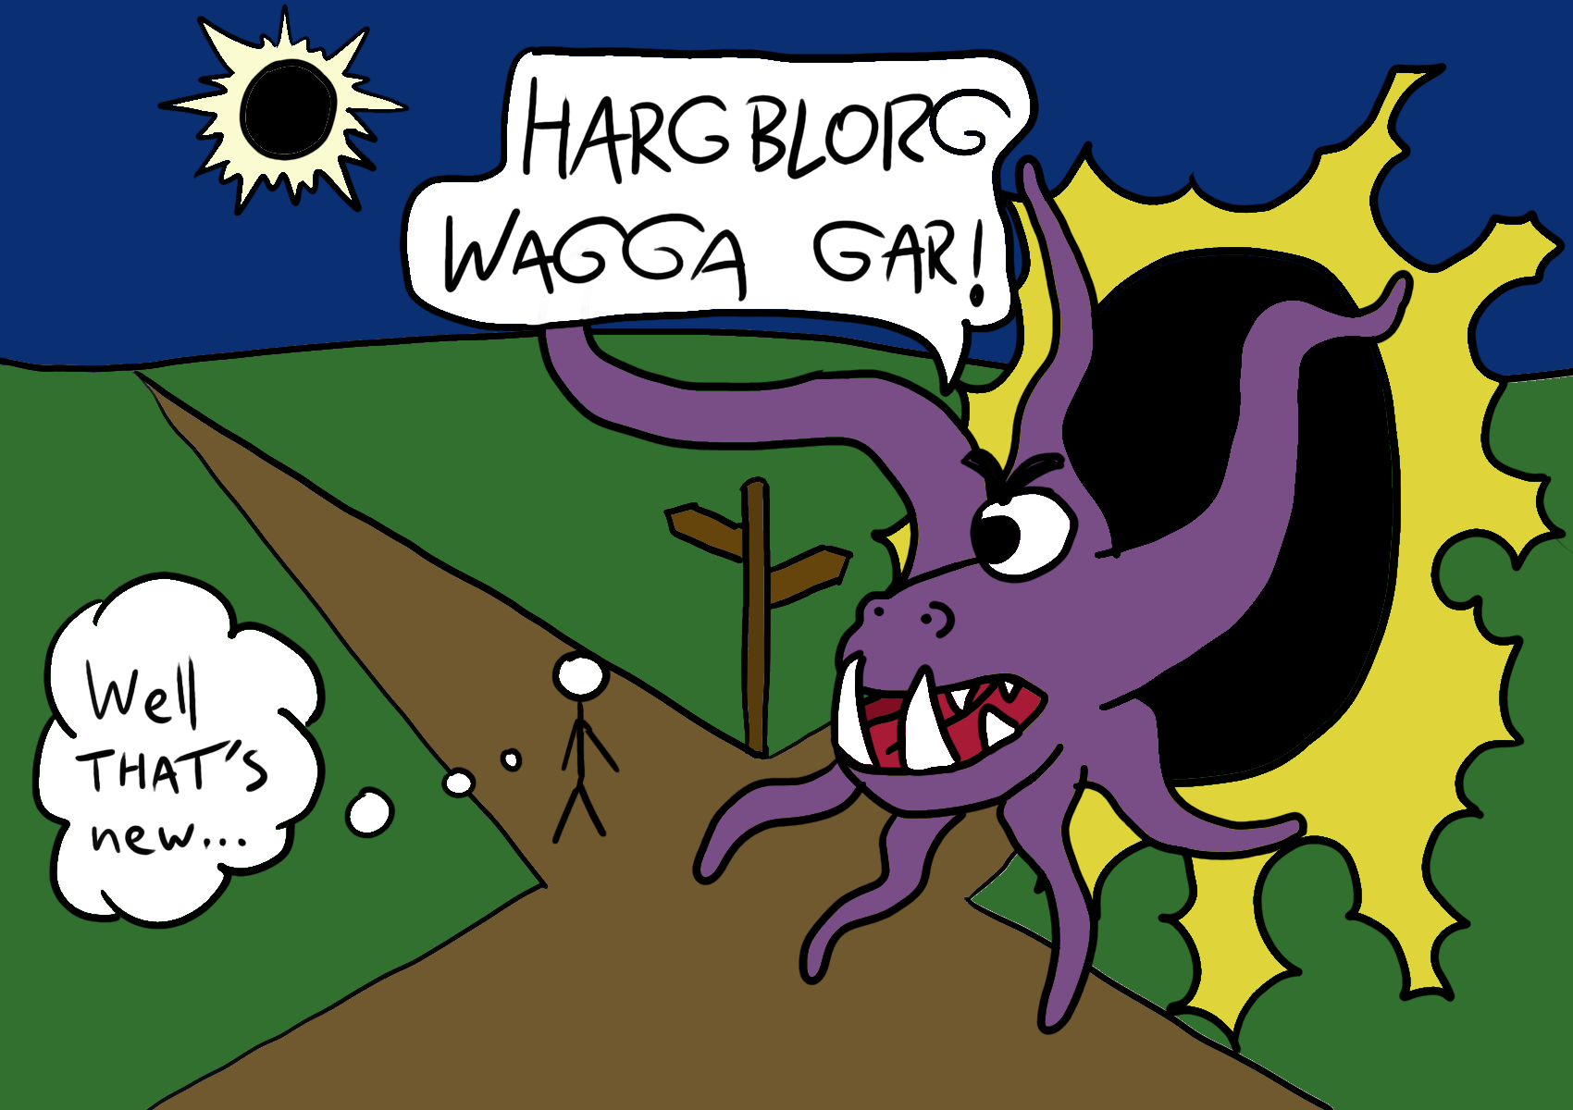
Notes:
We handle the routine with System 1 but novelty & conflict with System 1’s model engages System 2

Slide 79
Intentional learning usually requires evaluating our own success
Notes:
This is a system 2 thing!

Slide 80
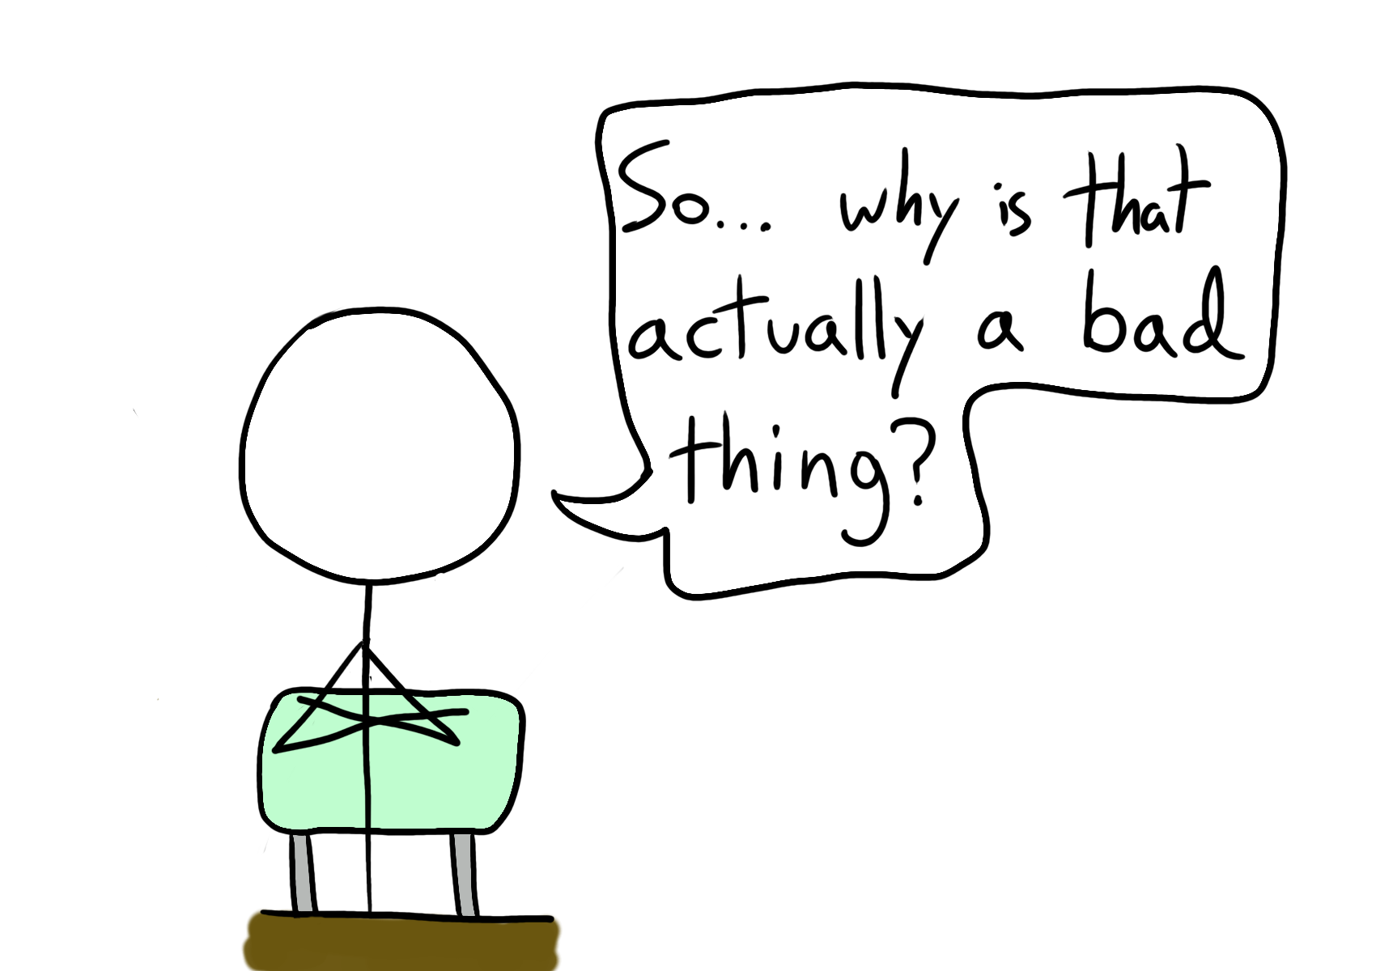

Slide 81
Well…

Slide 82
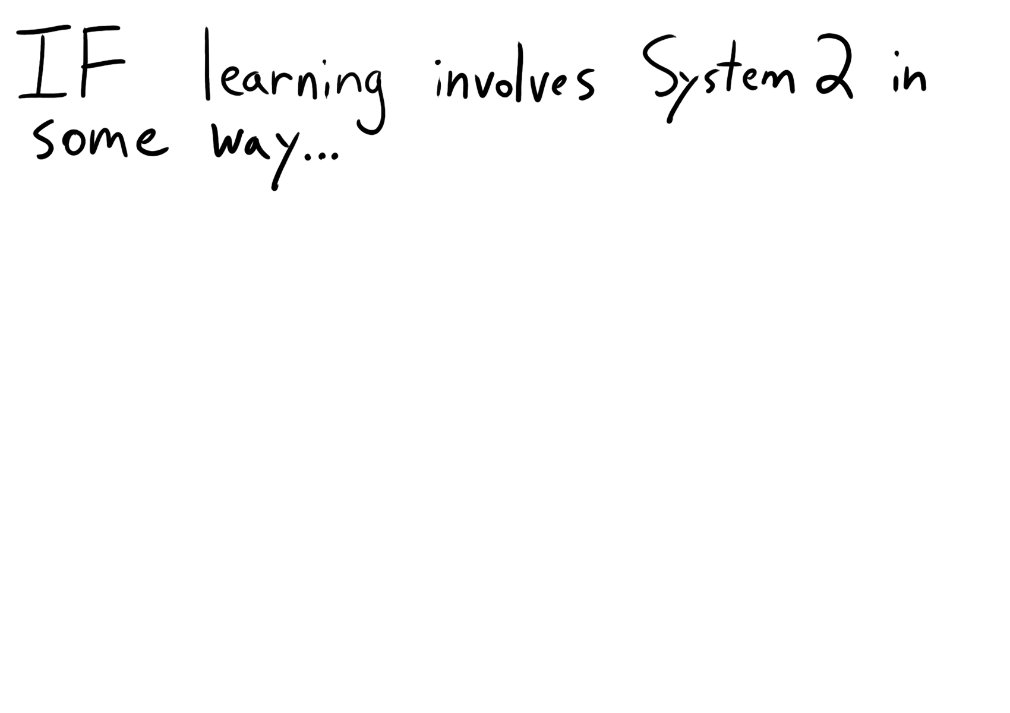

Slide 83

Kahneman, Thinking, Fast and Slow

Slide 84


Slide 85

Kahneman, Thinking, Fast and Slow
Notes:
As an example, we usually want to keep our theories-in-use fixed (leading to dilemmas)

Slide 86


Slide 87

Notes:
Chase effort. Not intensity, but frequency Ideally you are low-level uncomfortable a lot

Slide 88


Slide 89
Know what mental effort feels like for you
Once you feel it: rest, reset, repeat!
Try switching your context for a quick rest
Catch yourself taking the easy way out
Notes:
Cloudy head
A sense of pressure in the skull (my brain is full!)
Exhaustion
Irritation
Should I break here?

Slide 90


Slide 91


Slide 92


Slide 93
Would some pithy quotes help?

Slide 94

“Growth and comfort do not coexist.”
– Ginni Rometty, CEO of IBM 2011 – Present
Image Source: Wikimedia (https://en.wikipedia.org/wiki/Ginni_Rometty#/media/File:Ginni_Rometty_at_the_Fortune_MPW_Summit_in_2011.jpg)

Slide 95

“Do one thing every day that scares you.”
– Mary Schmich, Chicago Tribune
Image Source: Chicago Tribune (http://www.trbimg.com/img-559d3cfb/turbine/chinews-mary-schmich-20130507)

Slide 96

“Always do what you are afraid to do.”
– Popularized by Ralph Waldo Emerson
Image Source: Wikimedia (https://upload.wikimedia.org/wikipedia/commons/d/d5/Ralph_Waldo_Emerson_ca1857_retouched.jpg)

Slide 97

“You must do the thing you think you cannot do.”
– Eleanor Roosevelt, First Lady
Image Source: Wikimedia (https://upload.wikimedia.org/wikipedia/commons/2/22/Eleanor_Roosevelt_portrait_1933.jpg)

Slide 98
Okay, here’s some actual reasons

Slide 99
Reason 1: The Comfort Zone breeds holy wars

Slide 100
if (x < 0) {
puts("Negative");
} else {
nonnegative(x);
}

Slide 101
if (x < 0)
{
puts("Negative");
}
else
{
nonnegative(x);
}

Slide 102

Notes:
This is what leads to Holy Wars!

Slide 103

Notes:
Noodles conflates “familiarity” with both “goodness” and “truth” – the more familiar something is to us the more we like it (& find “rational” reasons to like it) (This is availability heuristic)

Slide 104

Notes:
Once we’ve invested in being a “vim user” or “java developer” or “TDD advocate” we want to avoid the loss of admitting we were wrong (Loss aversion)

Slide 105
Reason 2: Escaping Local Maxima

Slide 106

Notes:
Discontinuous change of our theories-in-use is the only way to obtain appreciably better outcomes

Slide 107


Slide 108


Slide 109


Slide 110


Slide 111
Take the time to learn shortcuts
Try out the command line
Automate things
ASK WHY!

Slide 112
Reason 3: Neuroplasticity & Neurogenesis

Slide 113
Learning things enables us to keep being able to learn new things & avoids degeneration with age
Fernández-Ballesteros, Molina, Schettini, and del Rey, 2012

Slide 114


Slide 115
Hand-write your notes
Draw it out or print it out and shuffle it
Fidget & move
Use brainstorming techniques that involve varied types of input

Slide 116
Reason 4: Growth as a person and a developer

Slide 117


Slide 118


Slide 119


Slide 120
Write a blog post
Give a talk
Get accepted for a talk to force yourself to learn it
“Rubber duck”/“Cardboard cutout” debugging

Slide 121
Reason 5: TMFI
Notes:
the amount of information is too damn high and too damn fast

Slide 122

Eddie Obeng, Qube.cc

Slide 123
We have to be good at learning…
AND at knowing what we have to learn…
Or we can’t keep up.

Slide 124
To Summarize

Slide 125
We learn via several different processes, almost all of which require System 2

Slide 126
We can tell if we’re actually learning by noting that we feel cognitive effort

Slide 127
BURN YOUR COMFORT ZONE!

Slide 128
Chasing that effort keeps us pushing forward and learning

Slide 129
Seek novelty & change Expose ourselves to as many viewpoints as we can Be open to being surprised

Slide 130
Use as many parts of the brain as we can when learning Use multiple senses Tell someone else what you learned

Slide 131
Consciously evaluate your theories of action, double-loop-style

Slide 132




Arthur Doler
@arthurdoler
arthurdoler@gmail.com
Slides: http://bit.ly/2w6uHJc

